Slide 1
CONTRAST a presentation to the South Carolina School Business Officers Association
November 5, 2021
Myrtle Beach, S.C.
Mike Shealy, Senate Finance Committee staff

Slide 2
The Pandemic Era has been a Time of Contrast
“It was the best of times, it was the worst of times,
it was the age of wisdom, it was the age of foolishness,
it was the epoch of belief, it was the epoch of incredulity,
it was the season of light, it was the season of darkness,
it was the spring of hope, it was the winter of despair.”
Charles Dickens, A Tale of Two Cities

Slide 3
Washington Post Headline:
“The pandemic marks another grim milestone: 1 in 500
Americans have died of covid-19”
By Dan Keating, Akilah Johnson and Monica Ulmanu
Published Sept. 15, 2021
DHEC reports 13,670 deaths in South Carolina from COVID-19 — 11,819 confirmed and 1,851 probable deaths as of October 23, 2021.

Slide 4
“How COVID-19 vaccines were made so quickly without cutting corners” by Rachel Lance, Science News, June 29, 2021
Unlocking the coronavirus’ secrets
“To back up a bit first, designing the vaccines began far earlier than the jabs-in-arms stage. It began with deciphering the exact genetic makeup of SARS-CoV-2, the virus that causes COVID-19 (SN: 12/11/20). By early January 2020, that genetic blueprint was in hand and the first vaccines to test were ready just a few weeks later.
For some perspective, researchers first deciphered, or sequenced, the entire human genome over a span of almost 13 years, starting in 1990 and wrapping up in 2003 (SN: 1/17/03). Because of advances in computers, the same task now can take only hours.
Most crucially, researchers now had the genetic instructions for making the spike proteins that the virus uses to break into cells — a key ingredient for making the vaccines. Jutting out from the virus’ surface, these spike proteins make an easy target for the immune system to recognize. Researchers knew to zero in on those proteins thanks to decades of work studying coronaviruses, including two that have caused other outbreaks of human diseases — SARS and MERS. That work also identified the best form of the protein to use: a stable form just before the virus fuses with a cell it’s about to infect.”

Slide 5
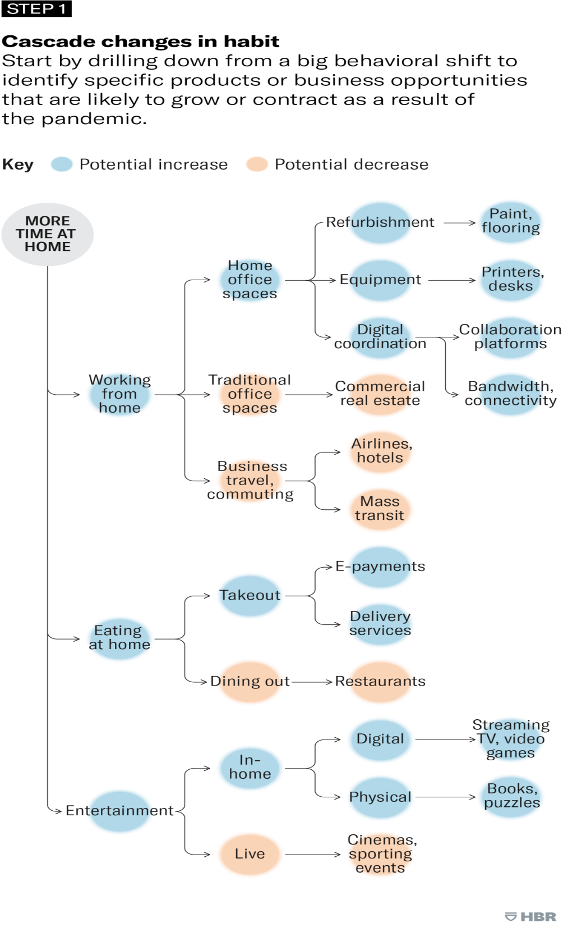
Harvard Business Review
“Adapt Your Business to the New Reality”
Start by understanding how habits have changed. by Michael G. Jacobides and Martin Reeves (September–October 2020)

Slide 6
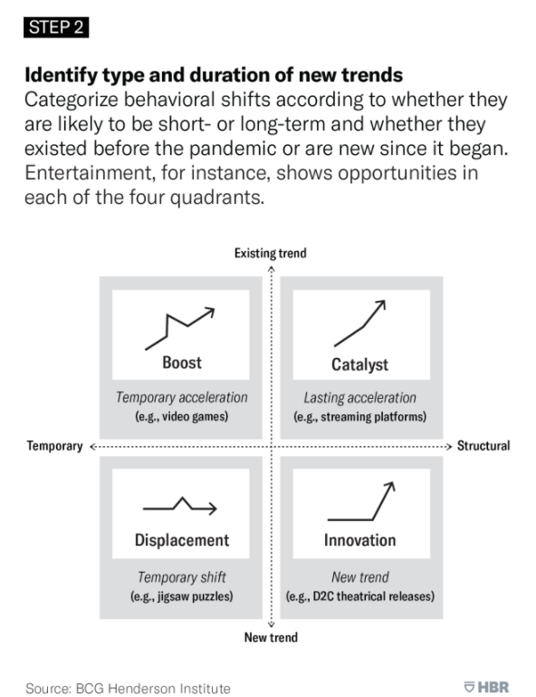
Harvard Business Review
“Adapt Your Business to the New Reality”
Start by understanding how habits have changed. by Michael G. Jacobides and Martin Reeves (September–October 2020)

Slide 7
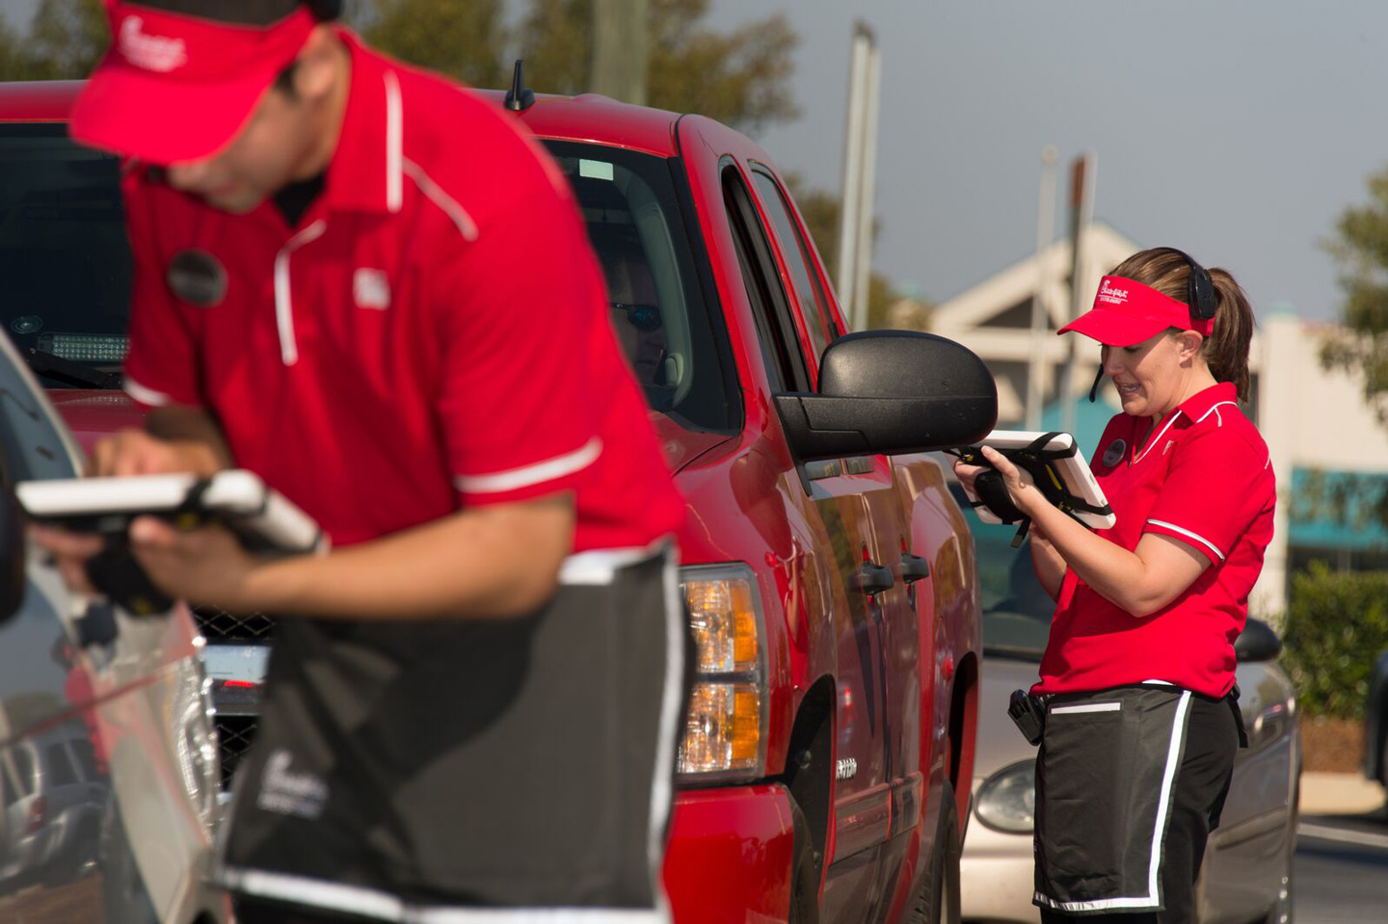
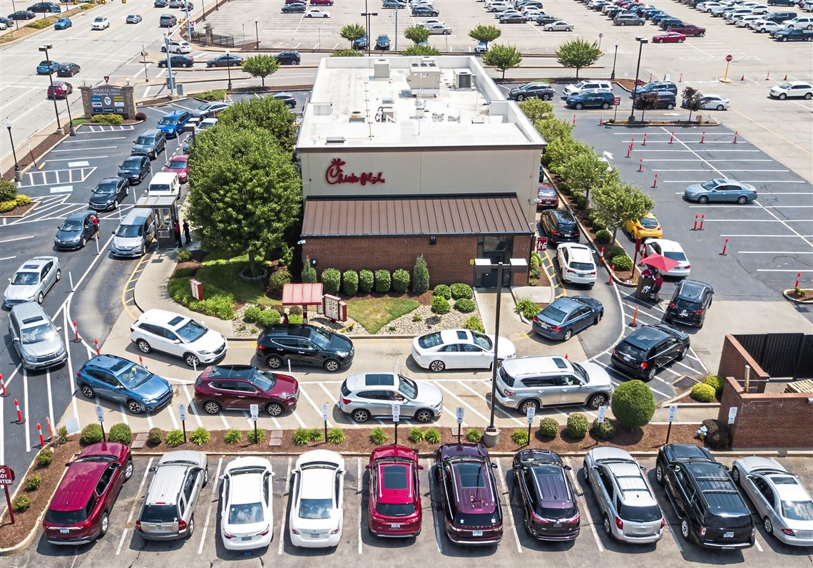
Adaptation
New Trend
Structural Change

Slide 8

Budget Status as of March 2020:
A Beautiful Horizon
Reflections on BC – Before Covid

Slide 9
FY 2020-21 General Fund Outlook (February 2020)
(PRELIMINARY- Dollars in Millions)
BEA Revenue Estimate (11/8/2019) | $10,229
- Tax Relief Trust Fund | ($629)
- FY 19-20 Appropriation Act | ($8,737)
Estimated “New” General Fund Revenue | $863
Reserve Fund Contributions
- Incremental General Reserve Fund (5%) | ($34)
- Incremental Capital Reserve Fund (2%) | ($14)
Estimated “New” General Fund Revenue Available for Appropriation (less Reserve Fund Contributions) | $815

Slide 10
FY 2020-21 Budget Outlook
(February 2020)
(PRELIMINARY- Dollars in Millions)
 | Recurring | Non-Recurring
FY 2019-20 Capital Reserve Fund |  | $162
FY 2018-19 Contingency Reserve Fund |  | $350
Projected FY 2019-20 Surplus (11/8/2019) |  | $507
Total |  | $1,019
FY 2019-20 HEX Fund Surplus/(Shortfall) |  | $8
FY 2020-21 HEX Fund Surplus/(Shortfall) | $17
FY 2019-20 EIA Surplus/(Shortfall) |  | $31
FY 2020-21 “New” EIA Revenue | $69
FY 2019-20 Lottery Surplus |  | $7
FY 2020-21 “New” Lottery Revenue | $7
¹ FY 2019-20 surplus lottery revenues are first appropriated to cover any shortfalls in LIFE, HOPE, and Palmetto Fellows Scholarships, so this surplus may not be available for appropriation. ² Lottery revenue is appropriated by proviso on a non-recurring basis. It is listed as recurring to show the net year to year increase in the estimate, excluding surpluses.

Slide 11
Exogenous Shock (Economic Term)
An exogenous shock is an unexpected or unpredictable event that occurs outside an industry or country, but can have a dramatic effect on the performance or markets within an industry or country.
Source: UN Economic and Social Commission

Slide 12
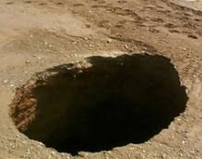
Exogenous Shock:
The bottom fell out.

Slide 13
“A Medically Induced
Economic Coma”
Council on Foreign Relations
April 8 2020

Slide 14
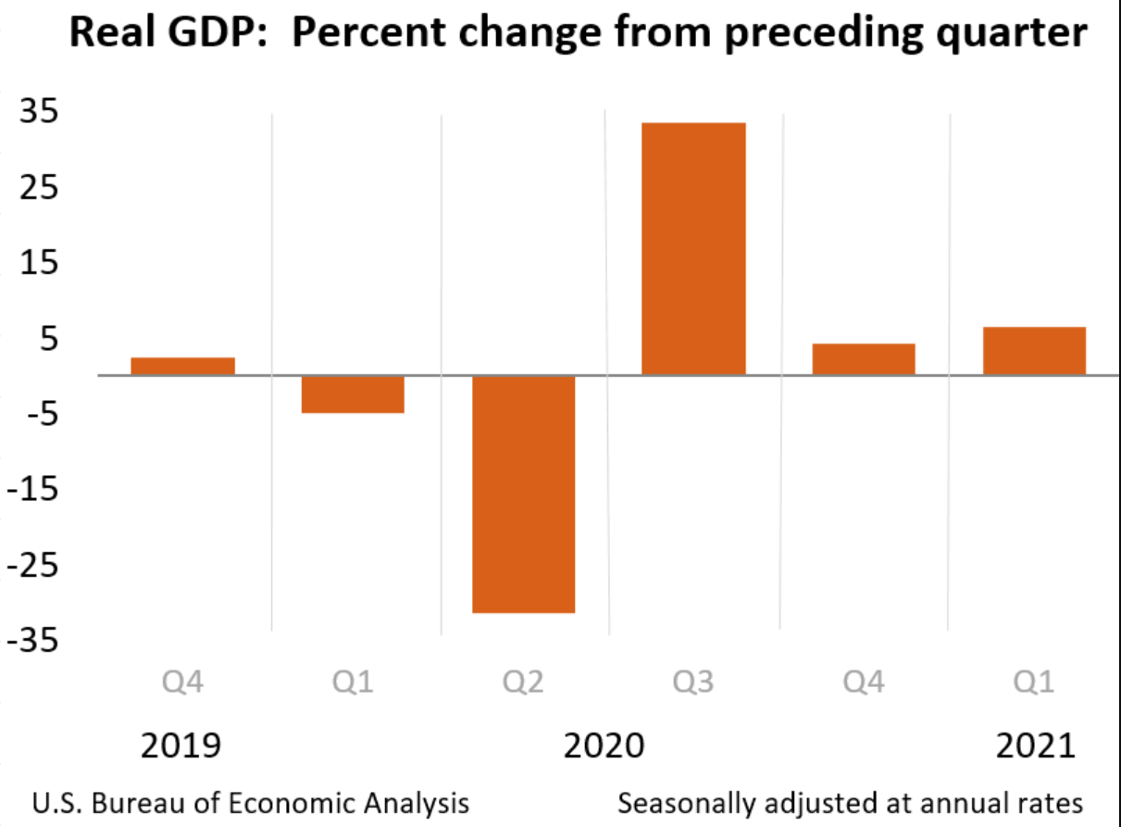

The Pandemic shutdown began in March of 2020 and was most severe in April, May and June.
In the 3rd quarter, businesses and organizations adapted. Grocery stores delivered to homes, restaurants served take-out food, offices rotated employees for less density.
Innovation led to a rebound.

Slide 15
The reaction of
South Carolina State Government ……

Slide 16
THE CONTINUOUS BUDGET PROCESS
DURING THE PANDEMIC - 2020
H4014 - $45M for DHEC immediate needs. Passed March 17th.
H3411 – Continuing Resolution – Continued the FY19-20 budget into FY20-21. In addition, $155M was appropriated from the Contingency Reserve Fund to the COVID-19 Response Reserve Account for specific COVID-19 related expenses. Passed May 19th.
H5202 – Authorization to spend federal CARES Act funds - $1.2B allocated and $668M left for Phase 2. Passed June 25th.
H3210 – Authorization to spend federal CARES Act funds from Phase 2. Passed September 25th.

Slide 17

The Reaction of the Federal Government to the Pandemic …
New Terms:
CARES
Rescue
ESSER
Traunch

Slide 18
Coronavirus Aid, Relief and Economic Security Act
March 27, 2020
Note: Represents about half of all federal spending on an annual basis.
CARES Act $2.0 Trillion
Individuals $560 Billion
Large Corporations $500 Billion
Small Businesses $377 Billion
State & Local Government $340 Billion
Public Health $154 Billion
Safety Net $ 26 Billion
Student Loans / Other $ 43 Billion

Slide 19
2021 - Additional State Appropriation Bills
H3707
A joint resolution to appropriate funds for addressing the pandemic.
One-time amounts of $63 Million for DHEC and $45 Million for MUSC were appropriated for vaccine delivery infrastructure.
In addition, $100 Million was appropriated to a COVID-19 Vaccine Reserve Account with $75 Million for hospitals and $25 Million for other partners for vaccine delivery.
Effective 2/19/21
H3609
A joint resolution to restore teacher step increases that were frozen due to the pandemic.
A one-time amount of $50 Million was appropriated for this purpose.
Effective 3/11/21

Slide 20
H4100 – General Appropriations Bill
(Spring of 2021)
Total Recurring General Fund Appropriations of $9.2 Billion.
Non-Recurring Appropriations of $1.3 Billion.
Total Recurring Budget size (with fed and other $) of $31 Billion.
Total Personal Income in SC (size of our economy) is $285 Billion (11%).
Due to the passage of a Continuing Resolution in FY20-21, H4100 was essentially a biennial budget.
Most importantly, by keeping spending at current levels during the worst days of the Pandemic helped SC avoid budget cuts which would have been devastating during the COVID – 19 response.

Slide 21
American Rescue Plan Act
March 11, 2021
Total $1.9 Trillion
Among the appropriations are:
State and Local Funds $362 Billion
Direct Financial Assistance $656 Billion
Individual and Family Assistance $ 56 Billion
Education and Child Care $212 Billion
Transportation $ 40 Billion
Other $ 61 Billion

Slide 22
American Rescue Plan Act
Funding Components for SC
State/Local Gov’t
$4.313 billion
Childcare
$709 million
Total
$8.9 billion
Education
$2.74 billion
Public Health
$391 million
Housing Assistance
$481 million
Public Assistance
$125 million
Other Programs
$118 million

Slide 23
State and Local Government
Fiscal Recovery Funds
State Government
Fiscal Recovery Fund
$2.499 billion
Capital Projects Fund
$188 million
Local Government
Counties
$1.0 billion
Metropolitan Cities
$191 million
Non-Entitlement Units
$435 million
$4.313 billion

Slide 24
Eligible Uses
Respond to public health emergency or its negative economic impacts including assistance to households, small businesses, and nonprofits, or aid to impact industries such as tourism, travel and hospitality.
Provide premium pay to workers performing essential work during the public health emergency.
Necessary investments in water, sewer, or broadband infrastructure.
Government services to the extent of reduce general revenue (revenue replacement).
Prevent/respond to crime and support public safety.

Slide 25
Prohibited Uses
Deposits to pension funds.
Offsetting reductions in net tax revenue resulting from change in law, regulation, or interpretation during the covered period (March 3, 2021 until December 31, 2024/2026).

Slide 26
Federal Funding Received to Date
# | Federal Legislation | Amount
1 | Coronavirus Aid, Relief, and Economic Security Act (CARES Act) | $2,700,253,597
2 | Families First Coronavirus Response Act (FFCRA) | $193,574,784
3 | Coronavirus Preparedness and Response Supplemental Appropriations Act (CPRSA) | $10,698,741
4 | Paycheck Protection Program and Health Care Enhancement Act (PPPHCEA) | $120,346,602
5 | Coronavirus Response and Relief Supplemental Appropriations Act (CRRSAA) | $1,869,893,397
6 | American Rescue Plan Act (ARP) | $8,878,592,336
 | Estimated Total | $13,738,897,654
50% greater than the amount of federal funds the state receives annually
38% greater than the state’s general fund budget
43% of the total state operating budget

Slide 27
Legislative Subcommittees assigned to develop a blueprint for spending ARPA and SRS Funds
State Senate
House of Representatives
Senator Thomas Alexander (chair)
Senator Nikki Setzler
Senator Kevin Johnson
Senator Ross Turner
Senator Mike Gambrell
Rep. Bruce Bannister (chair)
Rep. Gilda Cobb Hunter
Rep. Bill Clyburn
Rep. Gary Simrill
Rep. Bill Herbkersman
Rep. Lonnie Hosey
Rep. Nathan Ballentine
Rep. Leon Stavrinakis
Rep. Todd Rutherford
Rep. Heather Crawford
Rep. Lee Hewitt

Slide 28
Legislative Priorities
Broadband
Water and Wastewater
Reimbursements for Lost Revenue
  General Fund (approximately $300M)
  Gas Tax (approximately $150M)

Slide 29

Magnitude of the Federal Stimulus in
16 months
$22 Trillion is the size of the US economy (GDP).
In a 12 month period of time, the federal government has injected the economy with roughly $4 Trillion (12 zeroes) in tax cuts or spending stimulus.
That’s 18% of annual GDP.

Slide 30
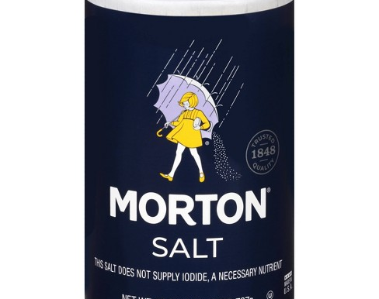
“When it rains, it pours.” (colloquialism)
Its origin comes from a fairly unlikely place: the Morton Salt Company. Yep, that's right. That expression which you use at least a handful of times a month was developed by ad execs in the early 1900s to sell salt. It's still, to this day, one of the most successful and lasting ideas to originate in those early days of advertising.
The Morton Salt Company was looking for a way to promote its new product, a free-flowing table salt. The product it was selling then looks nearly the same today, a blue cylindrical tube of free-running table salt with a handy pouring spout (a patent of the company's) seen in almost all kitchens across the country.
Source: Huffington Post, 8/31/12

Slide 31
Savannah River Systems Settlement Augusta Chronicle, September 3, 2020, by Jonathan Vickery
SRS lawsuit ends in $600 million settlement
Single largest settlement in South Carolina's history could benefit Barnwell County
“Years of litigation over plutonium waste at the Savannah River Site (SRS) has ended in a $600 million settlement.
The settlement between the State of South Carolina and the United States government ends six years of litigation related to the remaining 9.5 metric tons of weapons-grade plutonium relocated to SRS in the early 2000s. Under the terms of the of the settlement, the United States will pay South Carolina $600 million immediately. Also, the Department of Energy (DOE) remains obligated to remove the plutonium by 2037 or else monetary penalties will be reinstated and the DOE will be subject to additional litigation.”

Slide 32
Fiscal Year 2020-21 Year End Close of Books
Comptroller General - Budgetary General Fund Highlights
August 12, 2021
Undesignated/Unreserved General Fund Balance as of June 30, 2021
$1,023,777,259

Slide 33

Post-Pandemic Euphoria

Slide 34
“All good things must come to an end”
The idea contained in the expression “all good things must come to an end” originated with Geoffrey Chaucer (1342-1400), the English poet who also wrote the Canterbury Tales.
Source: Grammerist

Slide 36
Famous Presidential Words that have not aged well during the time of COVID – 19.
President Reagan’s News Conference, August 12, 1986
President Clinton’s State of the Union Address, January 23, 1996
"The nine most terrifying words in the English language are: I'm from the Government, and I'm here to help. "
“The era of big government is over.”

Slide 37
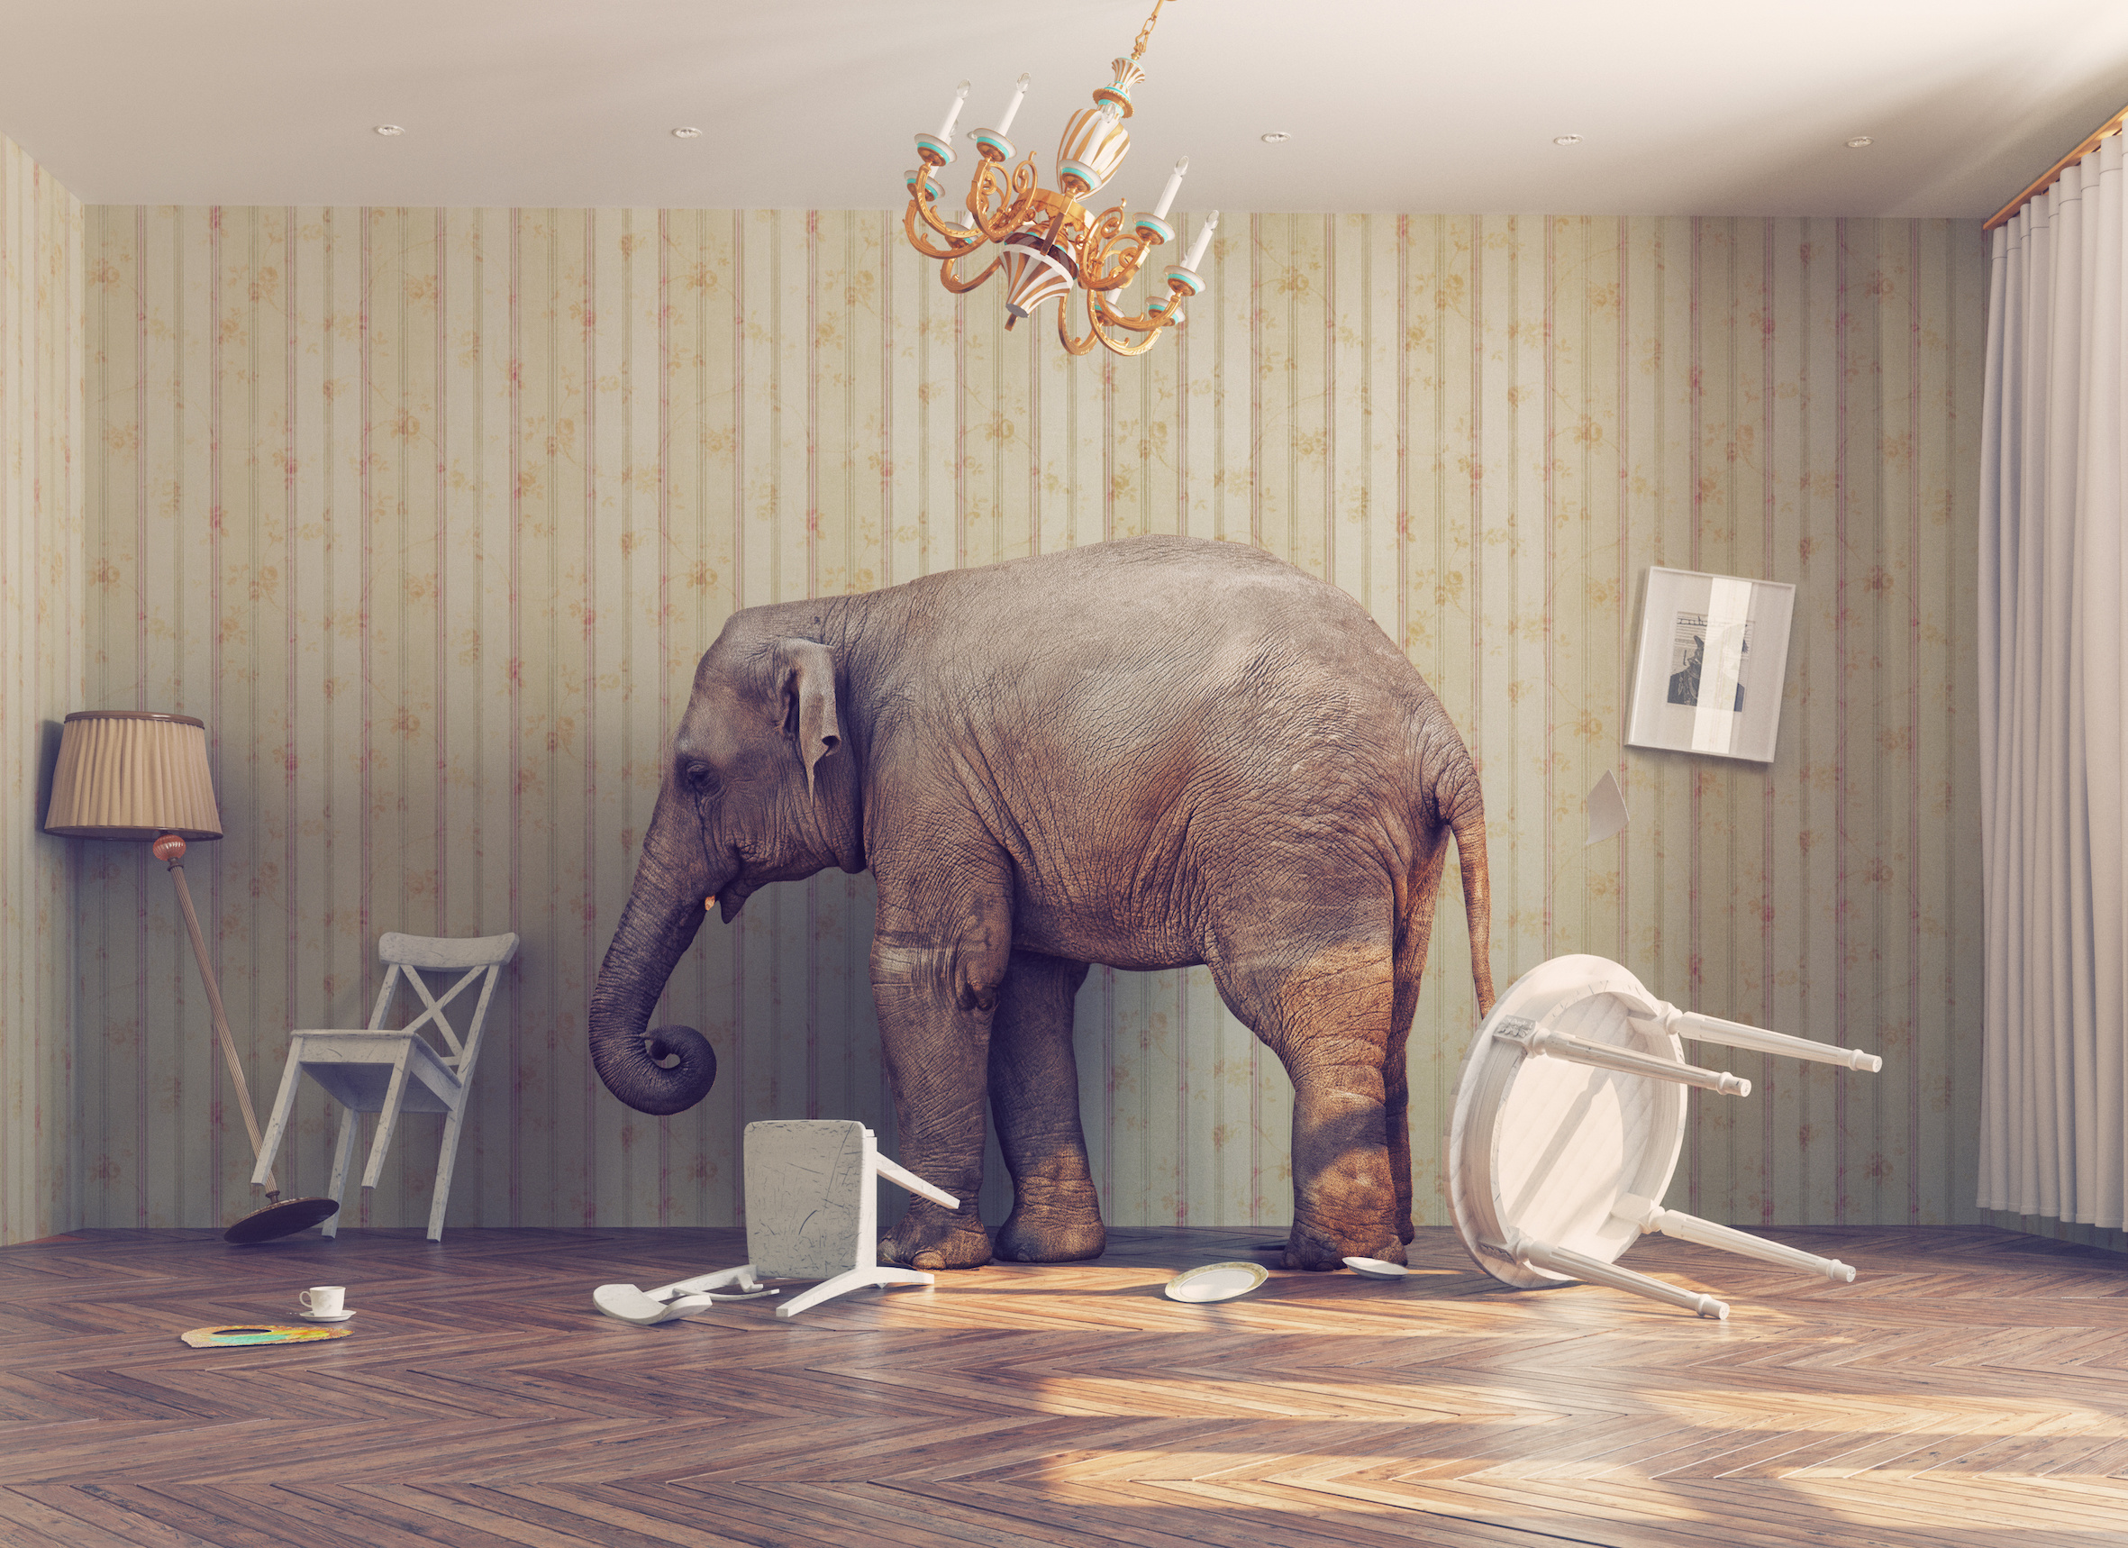
Now … to Address the Elephant in the Room

Slide 38
Mask Mandates – This budget proviso was added to H4100, the General Appropriations Bill, on June 9th when the House amended the Appropriations Bill to the 3rd degree.
1.108. (SDE: Mask Mandate Prohibition) No school district, or any of its schools, may use any funds appropriated or authorized pursuant to this act to require that its students and/or employees wear a facemask at any of its education facilities. This prohibition extends to the announcement or enforcement of any such policy.

Slide 39
3 Aspects to Understanding this Budget Proviso Beyond the Policy:
Legislative Process
Issue of Trust
Culture

Slide 40
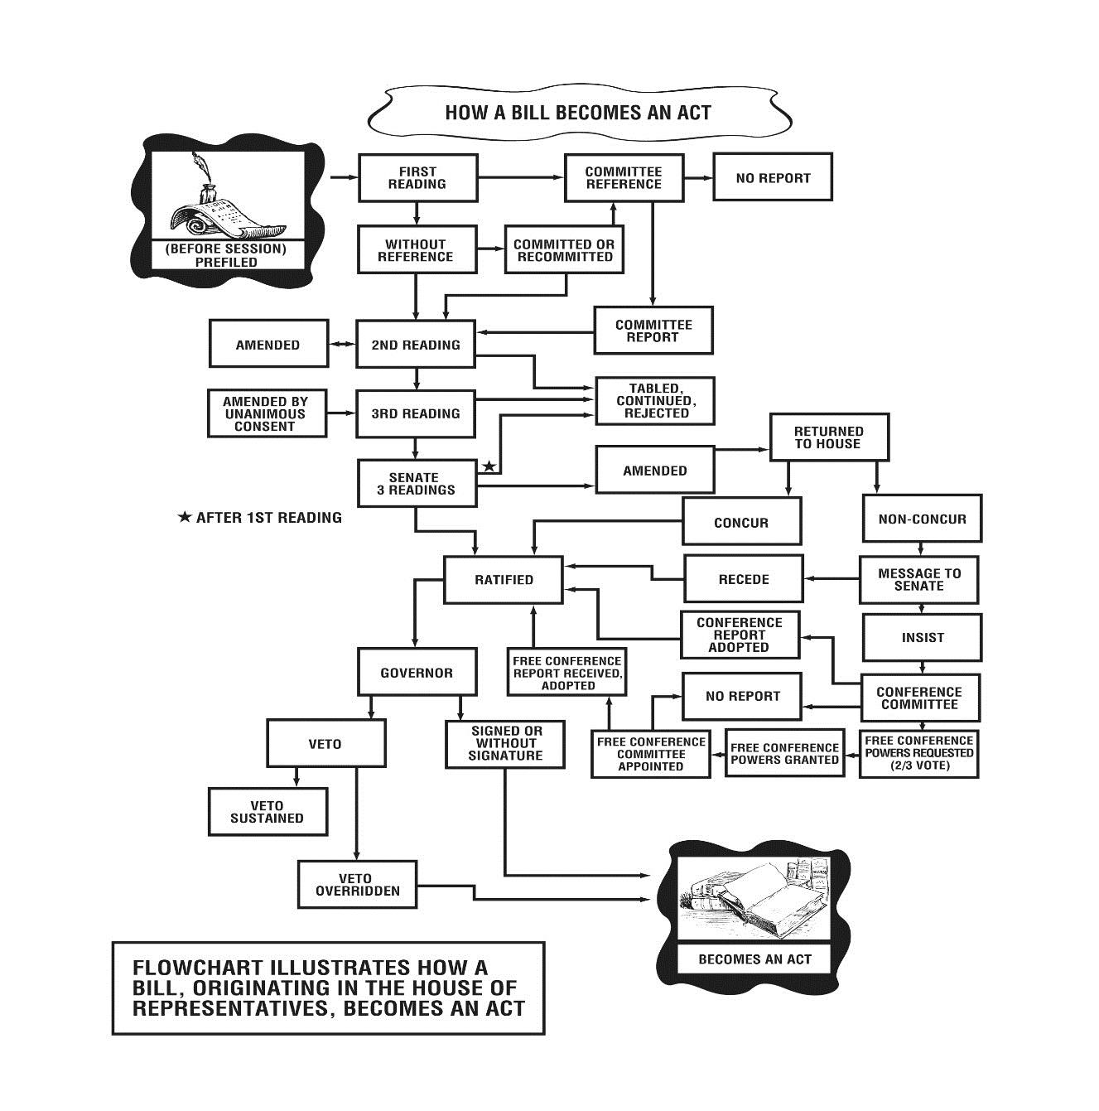
Legislative
Process
How a Bill Becomes an Act
The annual budget usually originates in the House. After passage, it is sent to the Senate. After Senate passage, it is sent back to the House. At that stage, the House may amend the budget one last time according to the Parliamentary rules used by the House and Senate.

Slide 41
Legislative Process
“How SC Gets Stuck With Bad Laws Most Legislators
Had No Interest in Passing” by Cindi Ross Scoppe, Charleston Post and Courier, Saturday, August 28, 2021
But whether the proviso stands or falls, it’s important to understand that using provisos to write state law allows at best narrow minorities and at worst extremists to hijack the legislative process and give us laws that don’t reflect the will of the majority of legislators, let alone the public.
There’s nothing new or unusual about getting stuck with bad laws that aren’t broadly supported because they were slipped in through budget provisos. Lawmakers used to pass a second category of provisos that became permanent law rather than lasting just the year the budget was in effect, and that’s how the Legislature opened up our state to the nation’s nuclear waste. And hazardous waste. And medical waste. It’s how the Legislature passed a bribery-tainted retroactive tax break. It’s how the Legislature legalized video gambling — in that case passing a proviso that was written so deceptively that no one even realized it was there, much less what a devastating effect it would have on our state.

Slide 42
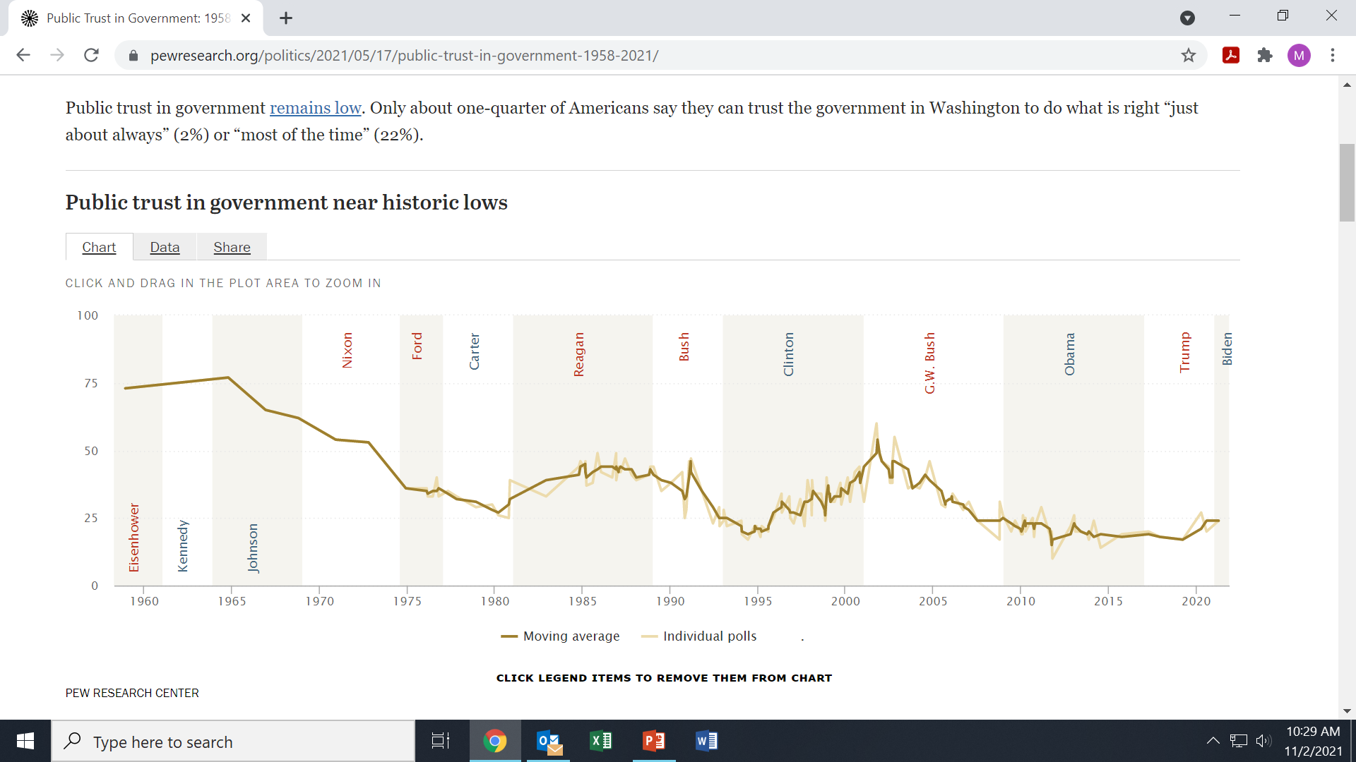
Pew Research Center Poll:
Public Trust in Government: 1958-2021 Issue of Trust
May 17, 2021

Slide 43
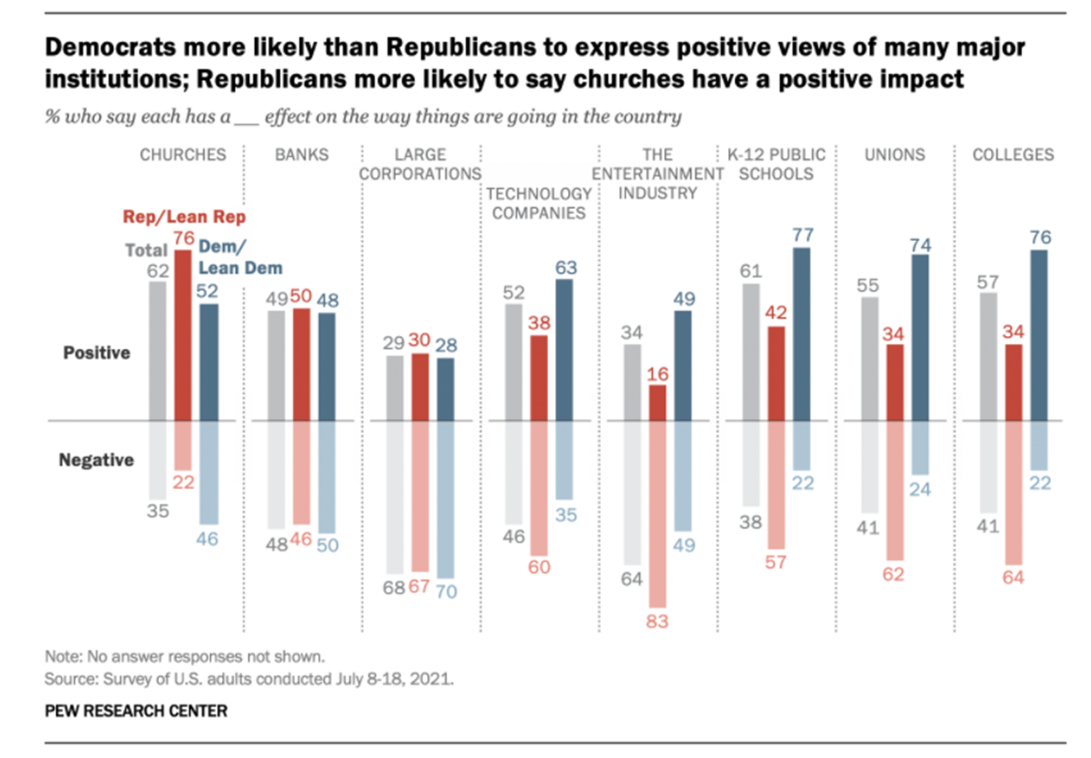
Issue of Trust
Pew
Research Center
Poll

Slide 44
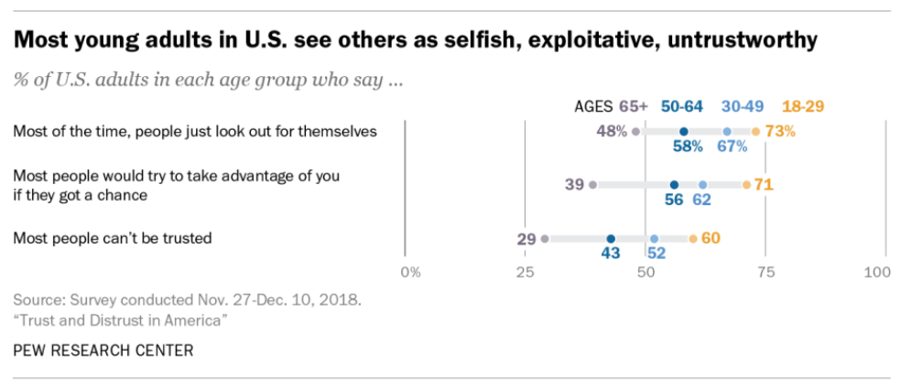
Pew Research Center:
“Young Americans are less trusting of other people – and key institutions – than their elders.”
August 6, 2019 by John Gramlich
Issue
of
Trust

Slide 45

CULTURE
In South Carolina we are particularly sensitive to tyranny
The Gadsden flag is named after revolutionary war hero General Christopher Gadsden of South Carolina.
Many colonists in South Carolina associated tyranny with King George III.
Even to this day, distrust of the executive yields the governmental structure we use today.

Slide 46
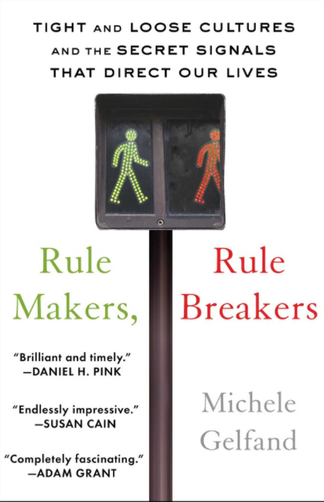
CULTURE
“Tight cultures have strong social norms and little tolerance for deviance, while loose cultures have weak social norms and are highly permissive. The former are rule makers and the latter are rule breakers.”
“Tightness-looseness is also distinct from previous ways that scholars have compared cultures, such as whether they are collectivist or individualist (collectivist cultures emphasize family ties; individualist cultures stress self-reliance). There are plenty of nations in each of the four quadrants: collectivist and tight (Japan and Singapore), collectivist and loose (Brazil and Spain), individualist and loose (the United States and New Zealand) and individualist and tight (Austria and Germany).”

Slide 47
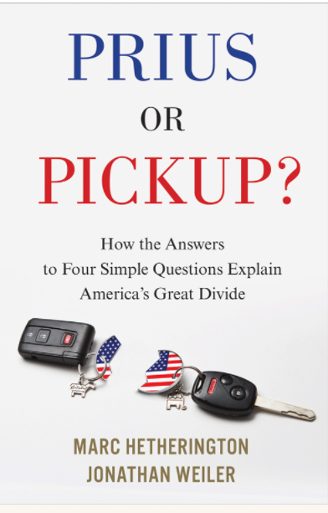
CULTURE
Fixed and Fluid
“The term “fixed” describes people who are warier of social and cultural change and hence more set in their ways, more suspicious of outsiders, and more comfortable with the familiar and predictable. People we call “fluid,” on the other hand, support changing social and cultural norms, are excited by things that are new and novel, and are open to, and welcoming of, people who look and sound different.”

Slide 48
Culture
4 Simple Questions from Prius or Pickup
Although there are a number of qualities that people feel children should have, every person thinks that some are more important than others. I am going to read you pairs of desirable qualities. Please tell me which one you think is more important for a child to have.
Independence versus respect for elders
Obedience versus self-reliance
Curiosity versus good manners
Being considerate versus being well behaved

Slide 49
Take Away
The past 18 months of the Pandemic have been a roller coaster.
Revenue did not perform as poorly as expected during the Pandemic.
Luckily, SC had cash on hand from March 2020 and beyond to deploy for COVID related expenses. Implementing a “Continuing Resolution” was key.
Federal stimulus funds are plentiful, and the deployment of these funds can be transformative for SC.

Slide 50
“The biggest communication problem is we do not listen to understand. We listen to reply.”
― Stephen R. Covey

Slide 51
THANK YOU

