Slide 1

Creative Strategies to Save Time, Money, and Frustrations…
while becoming an Employer of Choice
Presented by:
Steve Vermette
Tyrone Gainey

Slide 2
Building a public sector workforce
Recruitment and retention strategies for a new generation of workers

Slide 3
An aging society
5 4 3 2 1 Millions
GEN ALPHA
Born 2011 – 2025
Our nation’s adult population has increased faster than the under-age-18 population and the U.S. population as a whole in the last decade.
In 2022, the youngest Baby Boomer will be turning 58 and the oldest Millennial will be 41 years old.
By 2034, older adults are projected to outnumber children under age 18 for the first time in U.S. history.
GEN Z
Born 1997 - 2010
MILLENNIAL
Born 1981 - 1996
GEN X
Born 1965 - 1980
BOOMERS
Born 1946 - 1964
POPULATION BY AGE
U.S Census, 2020
SILENT GEN
Born 1929 - 1945
GREATEST GEN
Born 1928 - 1901

Slide 4

The double imperative
5,900
Average number of baby
boomers retiring every day.
As the Boomer demographic retires, we’ve been grappling with workforce challenges for some time:
The Silver Tsunami. The wave of retiring Baby Boomers (76 million people born between 1946 and 1964) who will be age 65 or older by 2030.¹ 40% of Baby Boomers were retired in September 2020.²
The Generational Gap. While 75% of the labor force will be 54 years and younger by 2029.³ There are not enough younger workers to replace those retiring, especially when younger workers are not likely to apply or stay in government or public sector jobs.⁴
Aging Baby Boomers Delay Retirement,
Annuity.org, February 24, 2020
1. “The pace of Boomer retirements has accelerated in the past year.” Pew Research, November 9, 2020. 2. “A double imperative: The public sector must address the Silver Tsunami and the millennial gap today.” Ceridian, June 26, 2020. 3. “Labor Force Share, by Age Group 1999, 2009, 2019 and Projected 2029.” U.S. Bureau of Labor Statistics, February 2021. 4. “Employee Tenure Summary.” U.S. Bureau of Labor Statistics, September 22, 2020.
Notes:
1. Richard Fry, “The pace of Boomer retirements has accelerated in the past year.” Pew Research. November 9, 2020.
Available at: https://www.pewresearch.org/fact-tank/2020/11/09/the-pace-of-boomer-retirements-has-accelerated-in-the-past-year/.
. “A double imperative: The public sector must address the Silver Tsunami and the millennial gap today.” Ceridian, June 26, 2020. 2. “Labor Force Share, by Age Group 1999, 2009, 2019 and Projected 2029.” U.S. Bureau of Labor Statistics, February 2021. 3. “Employee Tenure Summary.” U.S. Bureau of Labor Statistics, September 22, 2020.

Slide 5
Impact of the double imperative
45.6
In the third quarter of 2020, about 28.6 million Baby Boomers left the labor force due to retirement, a year over year increase of 3.2 million.
This marks a significant acceleration since the beginning of this generational transition in 2011 when the eldest boomers became eligible to retire, eclipsing the previous largest year over year increase of 2.5 million, which occurred between 2014 and 2015.
Median age of public
administration employees.
Of those age 45 to 64, 56.7% are federal, 49.7% are state, and 52.1% are local employees.
U.S. Bureau of Labor Statistics, Employed persons by
detailed industry and age, January 2021
Pew Research Center, The pace of Boomer Retirements has accelerated in the past year, November 2020

Slide 6
Impact of the pandemic
83%
Decimated commercial property markets and outsized shares
of unemployment in low to middle income jobs have harmed
local revenue streams that heavily rely on taxes.
March 2021, Bureau of Labor Statistics released jobs data showing another devastating loss in local government employment, adding to the nearly quarter million local government jobs already lost during the pandemic.
The financial impact of the recession hits at a time when the public sector was already challenged with attracting and retaining talent.
Of survey respondents
report recruitment and retention as a top priority.
Center for State and Local Government of Excellence, State
and Local Government Workforce Survey, April 2020
National League of Cities, Local Governments Bear Disproportionate Brunt of Job Loss, March 2021

Slide 7

Building a public sector workforce
At a time when demand has never been greater for its services, the public sector will need to balance continuing to provide for its constituents with the need to quickly rebuild its workforce with next generation talent.
Evaluate and update your recruitment and retention strategy to appeal to a new generation of workers.
Develop a customizable employee benefits package and communications strategy for multigenerational workforce.
Most importantly – be proactive and start now.

Slide 8
What do employees want?
Understand your workforce, what they consider valuable and make those options available. Personalizing the work experience will help improve morale and position you as an employer of choice with a purpose that aligns with their personal values.
High use of technology
CUSTOMIZED BENEFITS
PURPOSEFUL COMMUNICATIONS
valued by their employers

Slide 9

Competitive compensation
For government employers looking ahead, offering a competitive compensation package is most often ranked as their highest priority.
Based on a 2020 State and Local Government Workforce Survey, 85% of respondents rank offering a competitive compensation package as important – up from just 52% in 2012.
Center for State and Local Government of Excellence, State and Local Government Workforce Survey, April 2020

Slide 10

Personalized benefits
Much of our lives can be personalized from smartphone apps to tennis shoes, television stations to soda flavors.
Today’s employee expects every element of their job, from work to development to benefit options, to be customized, automated and accessible.
As benefit programs transition from strictly standardized to highly personalized, voluntary benefits can help employers be responsive to the different motivations, expectations and attitudes of each employee without adding to the bottom line.
10

Slide 11








Benefits customization
Though there are a variety of benefits being offered today, major medical health insurance and paid time off are often expected. In addition to salary and these standard benefits, there are there are a variety of ways you can create a comprehensive benefits package.
STANDARD
PERSONALIZED
Medical
Dental
Vision
Culture
Generation
Gender
Lifestyle
Industry
Notes:
OPTIONAL SLIDE. To go deeper into the conversation about voluntary insurance benefits, provide an overview of the products we offer.
SUGGESTED TALKING POINTS:
Some of the most popular voluntary benefits plans include options for dental and vision coverage.
Voluntary benefits can include medical coverage options for specialized issues, such as end-of-life care, cancer insurance, or catastrophic illness.
The wide range of options available allows employees to choose those voluntary benefits that suit their personal circumstances and lifestyle, whether they’re 20 or 50.

Slide 12
Beyond standard
With all the options currently available, it’s time for employers to move beyond a one-size-fits-most approach to benefits packages.
Buying and banking benefits. Alternative ways to save, spend or borrow. Examples: employee purchase programs, employee discount programs, credit union and flexible spending accounts.
Lifestyle and convenience benefits. Cost savings for the employee. Examples: childcare, elder care, pet insurance, auto insurance, adoption assistance, cyber security insurance and legal assistance.
Personal care and improvement benefits. Encourages proactive care of an employee’s physical, mental and financial health. Examples: financial counseling services, wellness programs, employee assistance programs and tuition assistance programs.
Financial safety nets. Protection from potential financial crises. Examples: home warranty insurance, homeowner’s insurance, identity theft protection and long-term care insurance.
Notes:
OPTIONAL SLIDE. To go deeper into the conversation about voluntary insurance benefits, provide an overview of the products we offer.
SUGGESTED TALKING POINTS:
Some of the most popular voluntary benefits plans include options for dental and vision coverage.
Voluntary benefits can include medical coverage options for specialized issues, such as end-of-life care, cancer insurance, or catastrophic illness.
The wide range of options available allows employees to choose those voluntary benefits that suit their personal circumstances and lifestyle, whether they’re 20 or 50.

Slide 13
Our recruitment and retention solutions
WAR FOR TALENT
Multi-generational
Customized products and program
Multi-cultural
Customized digital enrollment, paired with people
Customization
Employer cost savings
Silver Tsunami
Onboarding, new hire and offboarding strategies
THE UNEXPECTED
COVID-19 Pandemic
Affordable products
Personally fragility
Value-added programs
Financially fragility
Financial and personal wellness
Forced digital response
Digital communications and enrollment expertise

Slide 14









Enrollment modernization
As all business quickly pivots toward a digital response, we remain focused on offering solutions that are flexible, adaptable and scalable to ensure uninterrupted support for voluntary as well as core benefits enrollment.
By modernizing the enrollment, you can ensure every employee has an easy transition from learning about their benefit options (education) directly into choosing or purchasing (enrollment) their benefits options.
SINGLE
SITE
MULTIPLE
SITES
MULTIPLE LOCALES
DAYTIME
NIGHT TIME
WEEKENDS
IN PERSON
PHONE
ONLINE
14
Notes:
SUGGESTED TALKING POINTS:
In addition to our broad portfolio of voluntary insurance products, we provide comprehensive employee benefits delivery solutions and services customized to an employer’s business needs on a local and national level.
We create understanding.
Insurance benefits can get complicated quickly. We’re the experts at explaining them in straightforward, simple language.
We boost engagement.
Benefits are only useful when employees understand and value them. Our flexible enrollment solutions help increase participation in both core and voluntary benefits while dramatically increasing employee satisfaction levels.
We enroll all benefits.
Through our personalized benefits counseling sessions, we meet 1-to-1 with employees to help them understand their individual lifestyle needs and select the benefits that are right for them. Not just voluntary benefits, but also the core medical insurance, too.
Our flexible enrollment solutions, proven cost savings strategies, technology platforms and value-added programs all help to make doing business with us easier.

Slide 15

Digital transformation
Digitize the enrollment and communication process
Education is key — benefits are not second nature to the average employee
Pre-communication is critical... then engagement
Engage with a human. Screen-to-screen can be face-to-face — and very efficient
Employee portals and benefits administration systems exist — at no cost

Slide 16
Enrollment customization
Technology makes benefits easier and offers a better experience. The benefits industry will continue to accelerate digital transformation post-pandemic.
Human touch will remain critical for employee education and enrollment – but in a hybrid form with both digital and human interactions.
We’ve helped provide communications and enrollment solutions to many employers – even those in the public sector - during the pandemic.
CHANNEL PREFERENCE
“The COVID-19 effect: high tech with human touch to optimize life insurance customer experience.” LIMRA and BCG.
August 2020, "COVID-19 and life insurance customer experience." LIMRA. July 9, 2021.
Notes:
Rob Sims, Nathalia Bellizia, Gina Birchall and Todd Silverhart, “The COVID-19 effect: high tech with human touch to optimize life insurance customer experience.” LIMRA and BCG. August 2020.
2. Insurance Inspired 2021 Presentation, "COVID-19 and life insurance customer experience." LIMRA. July 9, 2021.

Slide 17






Boost engagement
Benefits are only an asset if employees understand them. That’s why providing customized benefits communication and education is our top priority.
Review the benefits package available to them.
Discuss any changes to the plan as well as potential impacts.
Promote wellness programs or other new offerings such as a health savings account.
Prepare employees for their enrollment decisions.
Customize to employer and employee preferences.
DIGITAL POSTCARDS
GROUP MEETINGS
MOBILE APPS
CUSTOM WEBSITES
EMAILS
DIGITAL BENEFIT BOOKLETS
17

Slide 18

Best practices
Ask. Understanding what benefits are of interest to your employees will then help you determine what you can provide.
Think outside the box. Be innovative when developing options that fit your company’s budget and help employees protect their wallets, their health and their well-being.
Communicate. Each line of coverage you offer needs an accompanying communications strategy to help employees understand it and evaluate its value.
Partner for success. You don’t need to exhaust your internal resources to provide a customizable benefits program.

Slide 19
Cooperative Purchasing
and Employee Benefits
Presented by:
Steve Vermette

Slide 20

Government spending
Combined, U.S. government agencies (federal, state and local) represent the largest customer in the world, spending over $7 trillion per year.
The federal government spends over $4 trillion per year while state and local agencies spend over $3 trillion.
Government spending is the largest industry in the U.S., representing over 13% of U.S. Gross Domestic Product (GDP) — manufacturing is second at 12% of GDP.
McKinsey.com, A Path to Successful State Procurement Transformation, May 2019
Notes:
States alone collectively spend more than $2 trillion each year on a portfolio that ranges from nuts-and-bolts operations such as snow removal to complicated IT systems such as whole-of-government enterprise resource planning (ERP) software.
The range of products that are sourced and the aggregate value of procurements solicited exceeds that of many multinational corporations.
Government spending is the largest industry in the U.S., representing over 13% of U.S. Gross Domestic Product (GDP) — manufacturing is second at 12% of GDP.
McKinsey.com, A Path to Successful State Procurement Transformation, May 2019

Slide 21
Procurement process
Procurement teams face two decisions:
What are you going to buy?
How are you going to buy it?
From this, they then have two choices:
Do you need to bid it?
Do you just need to follow a competitive bidding process?
Government buying is often referred to as procurement.
Due to taxpayer dollars being spent – or impacted – the competitive bidding process is intended to allow for a fair selection of products or services.
FOR INTERNAL TRAINING PURPOSES ONLY
Any unauthorized review, use, disclosure or distribution is prohibited.
Notes:
As stewards of public funds, city officials are acutely aware of the need to manage and spend taxpayer dollars wisely. Whether the spending is for office supplies, public safety equipment or public works projects, individuals responsible for procuring supplies and negotiating purchase agreements are at the forefront of safeguarding public funds.
Procurement teams face two decisions:
What are you going to buy?
How are you going to buy it?
Procurement teams have two choices:
Do you need to bid it?
Do you need to just follow a competitive bidding process?

Slide 22
Request for proposal
A Request For Proposal (RFP) is used to elicit bids from potential vendors for goods and services.
Whether an individual city, county, school district or other local agency preparing RFPs can be very cumbersome, time-consuming and expensive.
FOR INTERNAL TRAINING PURPOSES ONLY
Any unauthorized review, use, disclosure or distribution is prohibited.

Slide 23
Cooperative purchasing
Enables multiple public entities to purchase through a single contract.
Commonly used when purchasing tangible items such as tractors, computers and office supplies.
By pooling resources, public sector entities can leverage competitively solicited contracts from pre-vetted vendors - saving time and resources.
More agencies are shopping and buying through cooperative contracts. In fact, agency spend through cooperative contracts has grown from around 12% in 2011 to nearly 20% in 2017.
Accelerates the selection process by satisfying the bidding requirements without having to go through the RFP process.
Avoids duplicating the bidding and contract process.
Avoids the unpleasant experience of low bid, low quality responses.
Avoids time consuming and invalid vendor protests.
Saves money by not having to go out to bid.
Deltek , Survey of Government Procurement Professionals, 2018
Notes:
Cooperative purchasing is a very effective tool that procurement managers can use to obtain effective, best-value solutions.
By standardizing products and services and aggregating requirements, governments benefit from the combined economies of scale of multiple organizations.
Shorten the procurement lifecycle
Reduce errors
Lessen the workload
Keep the process accurate and consistent
Inject transparency into the process flow
Stick to the predefined procurement cycle

Slide 24

Cooperative purchasing
42% of the procurement staff surveyed said their teams were stretched to meet their deadlines — up 7% from the previous year.
Cooperative purchasing allows for reallocation of internal resources since administrative efforts and costs are spread across multiple governments.
87% of those surveyed said that they’re using cooperative purchasing.
GovWin, Survey of Government Procurement Professionals, 2018

Slide 25

Our cooperative contract
Group and individual voluntary insurance products.
Benefit enrollment and administration technology.
Flexible in-person, phone, and paper enrollment.
Employee engagement and benefit education.
Pre-tax employee benefit payments for tax savings.
Nationwide service and support.
We were awarded a contract, effective
until Nov 2024.
FOR INTERNAL TRAINING PURPOSES ONLY
Any unauthorized review, use, disclosure or distribution is prohibited.

Slide 26

Sourcewell advantages
Sourcewell is a government agency of the State of MN; all staff are public sector employees.
Through a joint powers agreement, they’re granted legislative authority to establish contracts for public sector agencies nationally.
Considered a “Third Party Aggregator,” they bring together multiple organizations to represent their requirements and manage the resulting contract.

Slide 27
Sourcewell member entities
STATE + LOCAL GOVERNMENT
  Cities
  Counties
  States and State Agencies
  Special & Water Districts
  Native American Tribes
  Port & Transportation Authorities
PUBLIC + PRIVATE EDUCATION
Facilitates competitive solicitation and awards process on behalf of over 50,000 public sector members nationally.
  K – 12
  Special Education Districts
  Charter Schools
  Higher Education & Universities
NON-PROFITS (tax exempt organizations)
  Hospitals & Nursing Homes
  Rural Power Cooperatives
  Housing Authorities
  Member Associations & Coops
FOR INTERNAL TRAINING PURPOSES ONLY
Any unauthorized review, use, disclosure or distribution is prohibited.

Slide 28

411
400 competitively bid contracts
200+ World-class Companies

Slide 29
411
400 competitively bid contracts
200+ World-class Companies

Slide 30
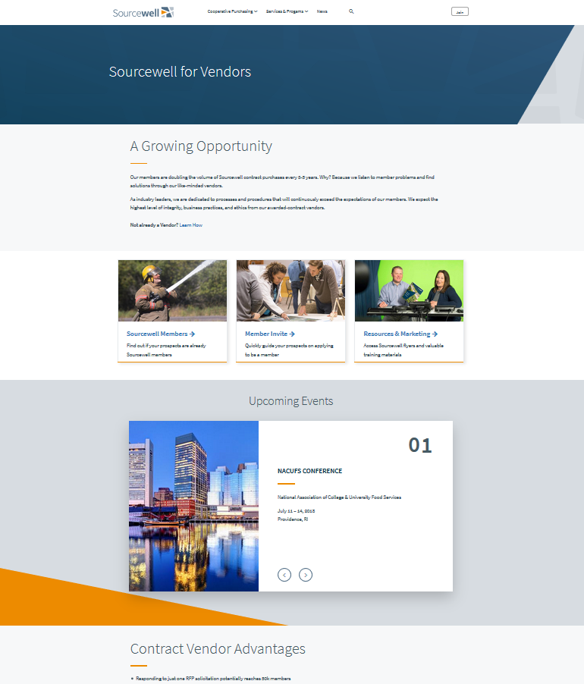

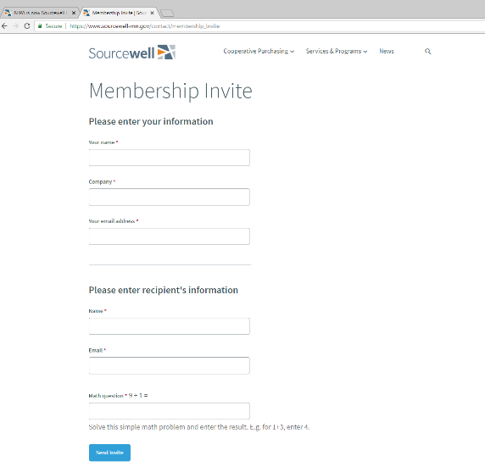
Sourcewell membership
Not a member? Not a problem!
Public sector entities can visit Sourcewell-mn.gov to register for a free – no obligation membership.
FOR INTERNAL TRAINING PURPOSES ONLY
Any unauthorized review, use, disclosure or distribution is prohibited.

Slide 31
Creative Cost
Saving Strategies
Presented by:
Tyrone Gainey
Senior Client Relations Specialist
Pierce Group Benefits
tgainey@piercegroupbenefits.com

Slide 32





Extra Level of Support. Extra Value.
Reduces need for more costly mental health services
Helps employees balance work/life demands
Improves productivity, reduces costs
Decreases turnover, absences and labor disputes
Help is available in multiple languages

Slide 33

EAP + Work/Life
In-person, telephonic and
video counseling available
Licensed Professional Counselors address stress, depression, family issues, substance abuse and more
Referrals for long-term counseling or specialized care
Plans customized to your needs

Slide 34

Work/Life Services
Work/Life specialists can locate childcare, legal and financial counselors, and more
24-hour access to website:
Online searches for child and elder care services
View archived webinars
Access to budgeting, home buying, loan and mortgage calculators
Personal Concierge Service

Slide 35
Talk to a Certified Financial Specialist
Half-hour phone or in-person consultation per financial issue; unlimited issues. Get help with:
Debt management, credit issues, budgeting, saving, bankruptcy
College/retirement planning, home refinancing

Slide 36

Talk to an Independent Legal Attorney
Half-hour phone or in-person consultation, with 25% discount on standard fees if retained. Get help with:
Debt management, credit issues, budgeting, saving, bankruptcy
College/retirement planning, home refinancing

Slide 37
Support for Supervisors & HR
Unlimited phone consultation and organizational services to help managers address:
Sensitive employee issues; conflict resolution
Critical incident planning
Disability management

Slide 38

Stretch your Benefit Dollars
Voluntary benefits provide vital options for today’s employee benefit programs, but there are additional ways to offer your employees greater choices and value.
If you’re not familiar with Section 125, or flexible benefit options, consider how they could help you enhance your benefits program.

Slide 39
SC General Statute does allow for a separate pre-tax plan from the PEBA benefits and is outlined below. Colonial Life was instrumental in getting the below legislation amended in 2001. Section (B) and Section (C) authorize parallel plans in political subdivisions which includes school districts. The parallel plan cannot duplicate benefits offered by the State in Section (A).
Section (B)
Section (C)
Section (A)
Political subdivisions may develop and implement a program for the administration of a flexible benefits or “cafeteria” plan as defined by Section 125 of the Internal Revenue Code of 1986, as amended, for their employees. The plan may not decrease contributions paid to or benefits paid by the System. For political subdivisions that also participate in the plan adopted pursuant to subsection (A) of this section, any separate cafeteria plan adopted pursuant to this subsection may provide benefits in addition to, but shall not include, the specific types of benefits provided to employees under the plan adopted pursuant to subsection (A) of this section.
An employer or coalition of employers working in concert may develop and implement a program for the administration of a flexible benefits or “cafeteria” plan as defined by Section 125 of the Internal Revenue Code of 1986, as amended, for their employees. The plan many not decrease contributions paid to or benefits paid by the System. For employers or coalition of employers working in concert, that also participate in the plan adopted pursuant to subsection (A) of this section, any separate cafeteria plan adopted pursuant to this subsection may provide benefits in addition to, but shall not include, the specific types of benefits provided to employees under the plan adopted pursuant to subsection (A) of this section.
The System may develop and implement a program for the administration of a flexible benefits or “cafeteria” plan as defined by Section 125 of the Internal Revenue Code of 1986 for all employees covered by the health and dental insurance plan administered by the System. The plan may not decrease contributions paid to or benefits paid by the System.

Slide 40

Premium-Only Plan (POP)
Administration
A POP helps enhance your employee benefits package while potentially reducing taxes. The premiums for benefits under a POP are deducted from an employee’s gross earnings. Through a POP, you can:
Reduce employees’ taxable income, which can often mean reduced taxes for you and increased take-home pay for them.
Enable your employees to choose the benefits that best fit their needs and pay for them with pre-tax dollars.

Slide 41
Employee Example
How does the POP plan work?
Below is a generic example of how POP plan deductions can help increase your take-home pay.
 | Without POP | With POP
Salary (Gross pay based on 24 periods) | $1,000 | $1,000
Taxes | - $250 | ---
Voluntary benefits (if deducted pre-tax) | --- | - $100
Taxable Salary | $750 | $900
Taxes | --- | - $225
Voluntary Benefits (if deducted after tax) | - $100 | ---
Spendable Income | $650 | $760
Advantages to employees:
Provides employees the ability to tailor a benefits program to their individual needs.
Offers preferential tax treatment, which makes the purchase of employee benefits more affordable through tax savings.
Gives a potential increase in spendable income, or the opportunity to purchase additional benefits with their tax savings.
The illustration provided is for informational purposes only and not intended to reflect any particular, real-world situation. Taxes may vary by state and personal tax status.

Slide 42
Employer Sample Savings
Advantages to Employers:
Enhances their current benefits program by offering choices to meet the individual needs of the employees.
More affordable for their employees through preferred tax treatment.
Reduces their payroll taxes = TAX SAVINGS!
Example Employee savings - $265,231
Example Employer savings – $67,634
The illustration provided is for informational purposes only and not intended to reflect any particular, real-world situation. Employers should consult their tax advisors for information regarding their individual situations. Taxes may vary by state and by personal tax status. Deductions may vary by individual.

Slide 43

THANK YOU
4928 Linksland Drive
Holly Springs, NC 27540
www.PierceGroupBenefits.com
833-556-0006

