Slide 2
welcome
Debbie Elmore, SCSBA director of governmental relations and communications
Sandy Smith, SCASBO executive director

Slide 3
Notes:
Since y’all were kind enough to show up for this session and look like you really are interested in hearing more about what is going on in our General Assembly, I am thinking Sandy and I need to get after it and get on with the presentation.

Slide 4
the landscape
projected $1 billion in new revenue
year two of teacher salary raise to the national average ($60,000 in five years)
house speaker, education chair announces round two of education reform (teacher pay class sizes)
call to restructure state system of funding education that focuses on teacher pay and class sizes
education reform bill still on the table
2020 an election year
Notes:
As we head into 2020, here are a few things that the General Assembly is already talking about for 2020:
More money for the state budget? Looks like the state may have another great year of revenue growth. Projections are that the state may have more than $1 billion in new revenue -BEA and budget writers announced that revenue estimates may surpass last year’s $1 billion in new revenue. Lawmakers are already citing teacher pay, prisons, state retirement system as some of the budget priorities
Higher teacher salaries on the way? A year two of teacher salary raise to the national average ($60,000 in five years) - Speaker Harrell was quoted as saying the commitment to continue phasing in teacher pay increases over the several years to reach the national level will be a priority and given the impact of teacher advocacy last year, we can expect the pressure to continue.
Rounds two of education reform - House speaker and House education chair announced they will be meeting with invited teachers of the year in closed door meetings around the state to get their input into a possible legislation focused on teacher pay and class sizes.
Education funding reform? The House Speakers, Senate President and Governor directive to the SC Office of Revenues and Fiscal Affairs to study and make recommendations for restructuring the state’s system of funding K12 may result in legislation being filed for 2020. We will talk more about the proposed model released by call to restructure state system of funding education that focuses on teacher pay and class sizes
And don’t forget the massive education reform bill still on the table in the Senate. (House and Senate versions are drastically different creating an interesting and concerning compromise.
All of these issues and more will be up front and center in 2020 an election year

Slide 5
what off session?
House ad hoc Committee on Charter Schools
Joint Legislative Early Childhood Education Study Committee
Mold Abatement Joint Legislative Study Committee
Senate Finance Subcommittee on State Retirement System
Notes:
As we head into 2020, here are a few things that the General Assembly is already talking about for 2020:
More money for the state budget? Looks like the state may have another great year of revenue growth. Projections are that the state may have more than $1 billion in new revenue -BEA and budget writers announced that revenue estimates may surpass last year’s $1 billion in new revenue. Lawmakers are already citing teacher pay, prisons, state retirement system as some of the budget priorities
Higher teacher salaries on the way? A year two of teacher salary raise to the national average ($60,000 in five years) - Speaker Harrell was quoted as saying the commitment to continue phasing in teacher pay increases over the several years to reach the national level will be a priority and given the impact of teacher advocacy last year, we can expect the pressure to continue.
Rounds two of education reform - House speaker and House education chair announced they will be meeting with invited teachers of the year in closed door meetings around the state to get their input into a possible legislation focused on teacher pay and class sizes.
Education funding reform? The House Speakers, Senate President and Governor directive to the SC Office of Revenues and Fiscal Affairs to study and make recommendations for restructuring the state’s system of funding K12 may result in legislation being filed for 2020. We will talk more about the proposed model released by call to restructure state system of funding education that focuses on teacher pay and class sizes
And don’t forget the massive education reform bill still on the table in the Senate. (House and Senate versions are drastically different creating an interesting and concerning compromise.
All of these issues and more will be up front and center in 2020 an election year

Slide 6
upar
Notes:
If anyone has any questions or wants to add something to the conversation, be sure to raise your hands upar so we can see you. And you can do it at any point of our presentation.

Slide 7
funding reform
Senate committee studying funding reform
retiree return to work
proposed funding model released early October by RFA
model driven by cost of teachers, target student-teacher class ratios
funded by redirecting existing state funds and not based on adequacy
Notes:
Let’s start with the first major issue – education reform or what we think is more funding restructuring or redirecting …
Proposal released

Slide 8
Notes:
Asbestos we can tell, this funding proposal includes the following

Slide 9
funding reform
state funding distributed to school districts in three expenditure categories with common set of formulas for specific items:
instruction
facilities
district services
using 2018-2019 data, the total cost of model ($5.4 billion) includes $4.2 billion (77.5%) in state funds and $1.2 billion (22.5%) in local funding equal to 75 mills in each district
no inflation factor – driven by policy changes
Notes:
State funding is distributed in three major categories.

Slide 10
Notes:
Well I was thinking I would not mention this next issue because I am not sure it will pass but nehmine.

Slide 11
education savings account
legislation in House and Senate
two hearings in Senate, another scheduled but cancelled
modeled after Nevada program – most expansive in the country
fiscal impact is tremendous loss for public schools

Slide 12
Notes:
Let’s just hope I’m accurate about describing what is in the ESA legislation…

Slide 13
education savings account
parents who withdraw child receive public funds placed into a state-authorized account to send their child to private school
money pays for tuition, expenses usually through a debit card
amount equal to state funds per student – “shared expenses per pupil”
eligibility limited for first two years and open-ended in year three

Slide 14
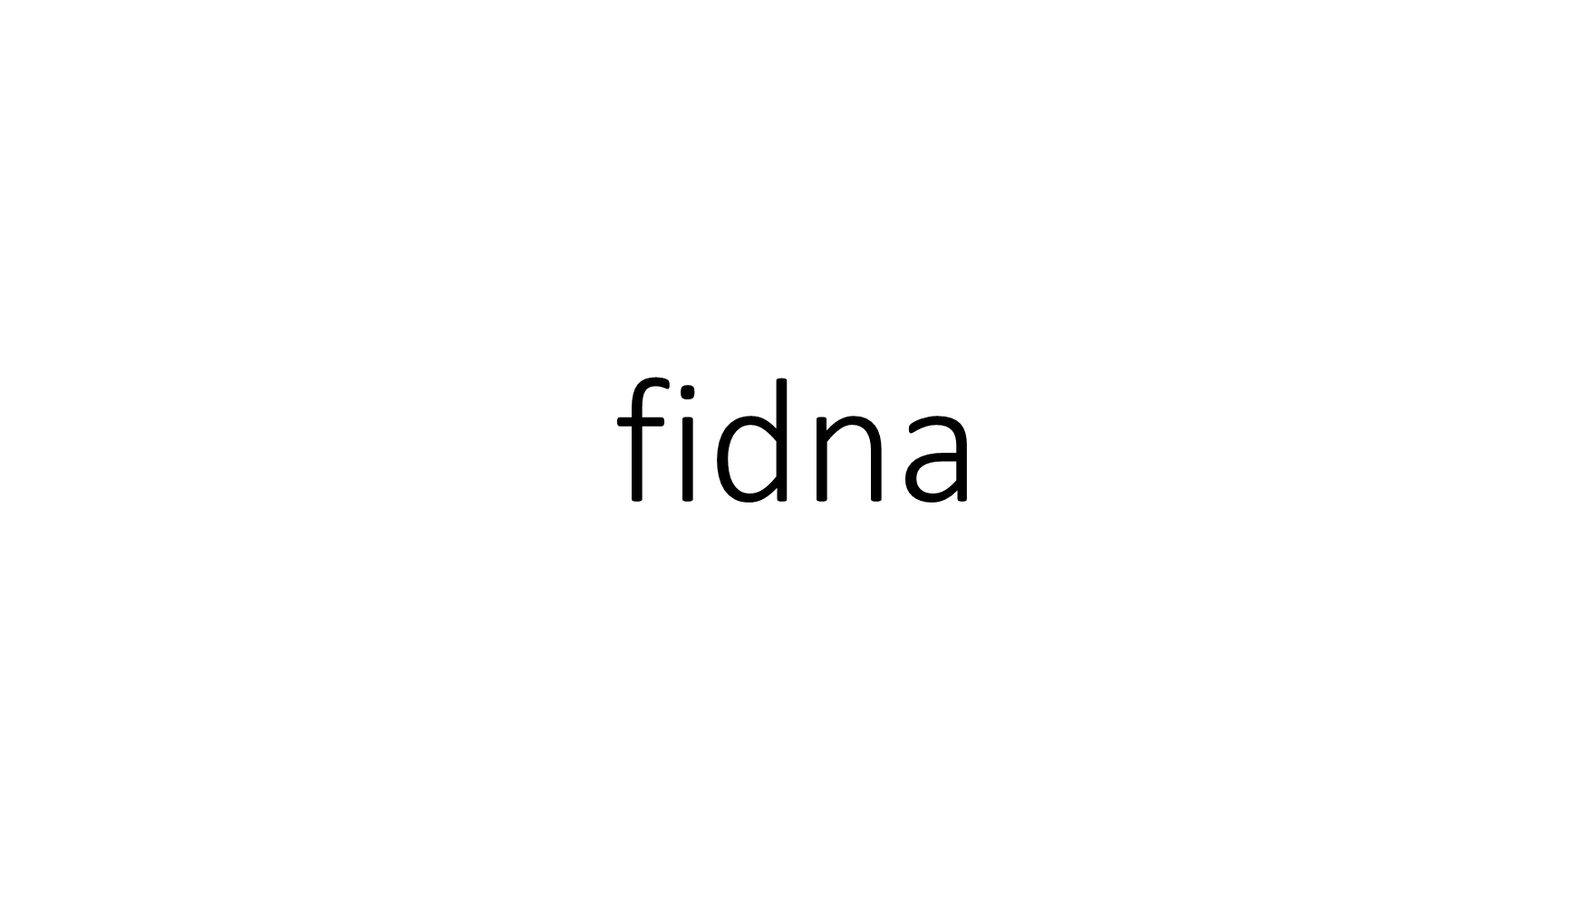
Notes:
On this next issue, I’m fidna to get all riled up because we’ve been pushing for this every year for the past several years but we aren’t getting it done!

Slide 15
school start date
several bills still on the table from 2019
time is now to allow school boards to set their own start date
too difficult to complete 90 instructional days before December break
cannot be done with knowing how lawmakers will vote
Notes:
Amending the uniform school start date to allow local school boards to set their own start date!

Slide 16
Notes:
Almost. Whew. I was thinking that we were pert near done with this presentation but we decided to add one more very important issue …

Slide 17
education reform
senate subcommittee continues to work on accountability sections of the bill
bill continues to be amended each meeting
looking ahead to compromise

Slide 18
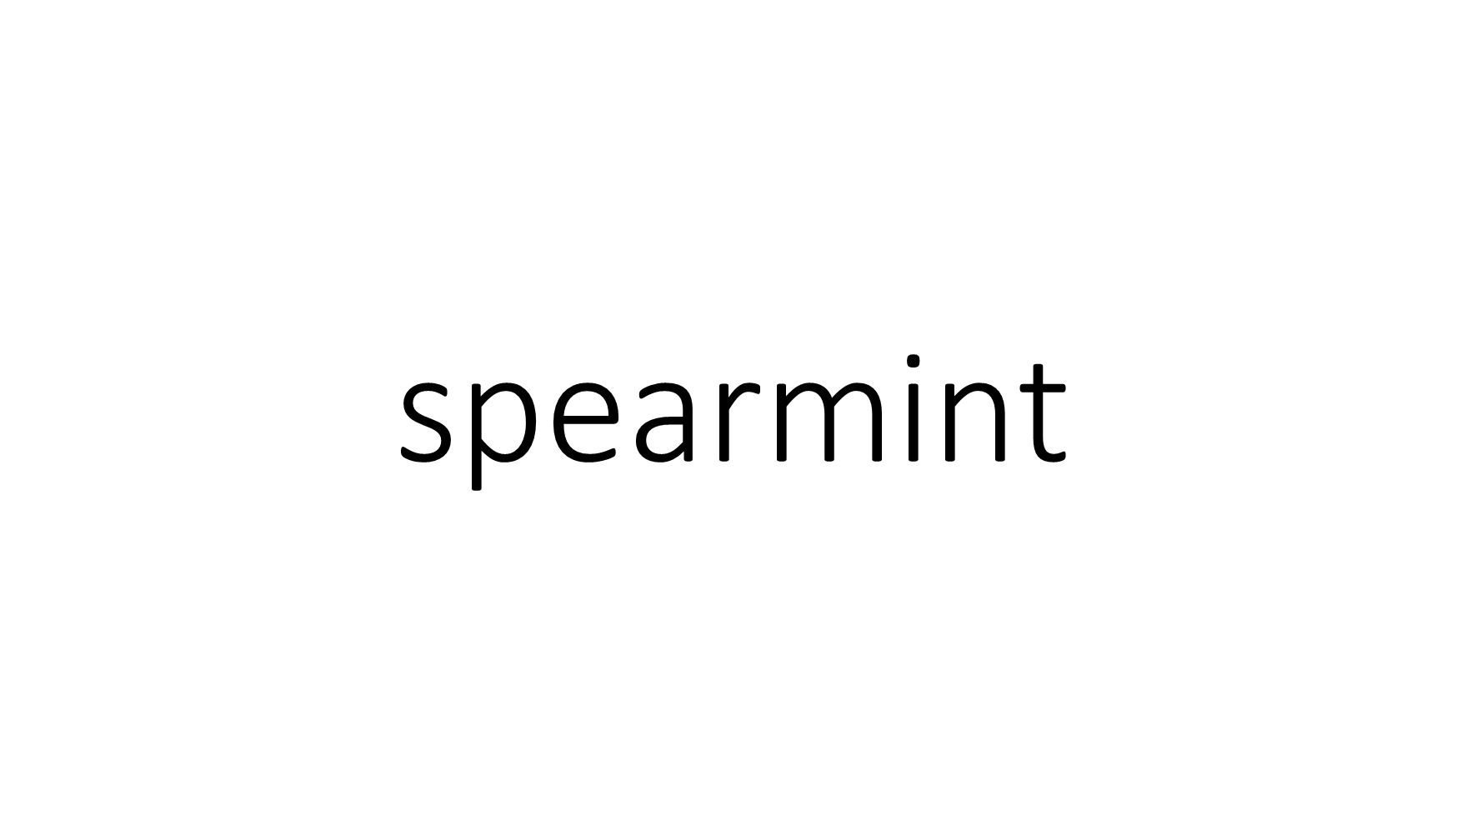
Notes:
Well we hope you have enjoyed us spearmintin with our southerner’s guide of legislative issues this morning.

Slide 19
fixinto
Notes:
And while we could go on and on, we aint because we are at the end and fixin to head to Bojangles in few minutes

Slide 20
Notes:
Cause I have a hankern for some sweet ice.

Slide 21
Thank y’all!

