Slide 1

SC Department of Education
SCASBO FALL CONFERENCE
Melanie Cooper, Finance Director
November 8, 2024
Notes:
Slide title should be Aptos Bold font, left-aligned, not smaller than 44pt
Audience – To whom/group you are presenting to
Speaker – Who is giving the presentation (may be by name or by department)
Date – Date of presentation

Slide 2
Agenda Item #1
  SC Educator
Notes:
Agenda is 88 pt
Line item is 66 pt

Slide 3
SC Educator-Primary Focus
  Catalog all professional staff employed by a district during the current school year
  Update credit for total years of experience for educators to the Office of Educator Services
  Data transfer to SC Lead for evaluation and assessment purposes
  Provide information for funding related to National Board and Teacher Supply
  Provide educator reports to the General Assembly
Notes:
Not much has changed in SC Educator, and the primary focus is still to catalog staff employed in the district. Update experience for educators, provide evaluation data via SC Lead, provide funding information for National Board Candidates, and Teacher Supply, and lastly prepare educator reports.
Emails or calls regarding
Experience credit not updating
SC Lead evaluations for educators (due to location assignment or position coding)
National Board status
Change in class ( educators who move from a bachelors to a Masters in current year)

Slide 4

SC Educator Deadlines
  November 30th -PCS Staff updates for Teacher Supply
  June 30th -Final Staff updates for current school year, SC Educator will close at 5 pm
Notes:
Header font 50pt
Content/body text font 26pt

Slide 5

Questions & Discussions
Notes:
Are there any questions, concerns, or feedback you may have regarding SC Educator.

Slide 6

SC Educator Contacts
Joshua Byers
    jrbyers@ed.sc.gov
Michael Scheele
    mscheele@ed.sc.gov
Notes:
Header font 50pt
Content/body text font 26pt

Slide 7
Agenda Item #2
  Dating Reporting
Notes:
Agenda is 88 pt
Line item is 66 pt

Slide 8
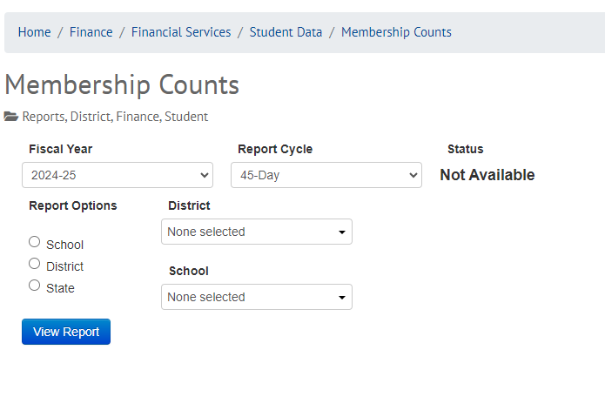
Data Verification Process
Code students in PowerSchool
Data transfer to SCDE (ED-FI)
Verify membership and student accountability data reports on SCDE website
CFO certified pupil accounting data is correct ( CFO will receive link via email)
SCDE will update State Aid to Classroom funding
Notes:
Wyatt confirmed the podium data is the same as what is being sent to the membership count page. The data is being updated daily, and he said he would provide an overall status update soon.
Dan Ralyea sent a reminder email yesterday and resent the Docusign email if you hadn’t signed as of yesterday at noon. Please continue to review the data and once you confirm is it correct please submit your signature.
You will not be able to verify student accountability counts for 3 and 4 year olds there is a know issue with the source data and our SCDE team is aware and working to resolve this issue.

Slide 9
Notes:
We included this chart to help grow your knowledge of ED-FI in South Carolina and support your learning of this publishing tool.

Slide 10
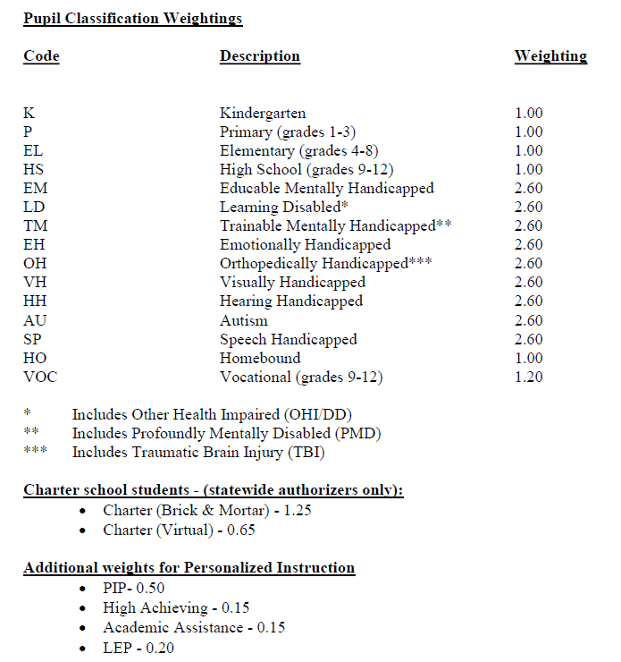
Pupil Classifications
Base Programs: K-12
Exceptional Programs: SPED classifications, Homebound
CTE courses
Add-on Weightings:
  High Achieving (HIAC)
  Academic Assistance (ACAS)
  Pupils in Poverty (PIP)
  Limited English Proficiency (LEP)
  Brick & Mortar (Charter Authorizers only)
  Virtual (Charter Authorizers only)
Notes:
Header font 50pt
Content left is 26pt
Content right is 28pt

Slide 11
FY25 Pupil Accounting Dates:
Membership Dates:
  45-day-10/24/2024-11/12/2024
  135-day-3/25/2025-4/16/2025

Slide 12
ed.sc.gov
Notes:
Slide title is hidden from display

