Slide 1
Legislative Update
Debbie Elmore
Director of the S.C. School Boards Association
Sandy Smith
SCASBO

Slide 2
2026 legislative session
Four new members:
  Sen. Lee Bright (Spartanburg
  Rep. Dianne Mitchell (Greenville)
  Rep. John Lastinger (Lexington)
  Rep. Greg Ford (Dorchester)
Less pre-filed bills than in the past
ELECTION YEAR

Slide 3
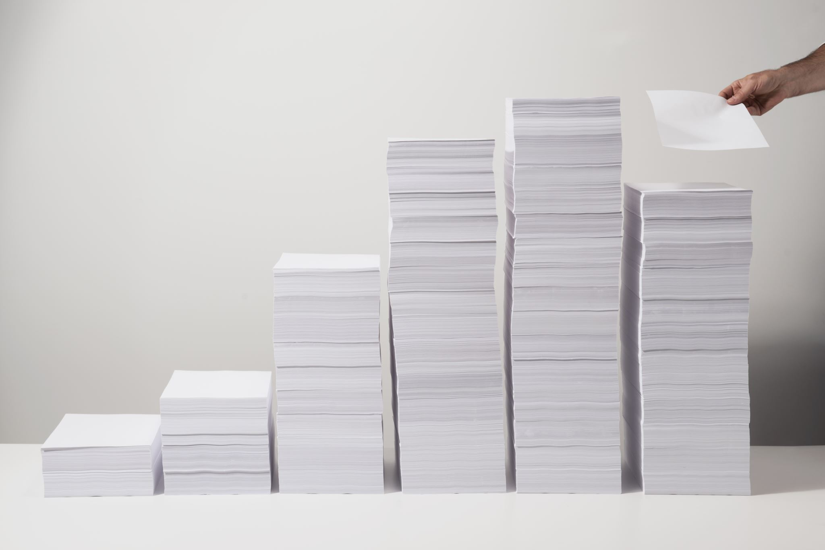
Budget Debate
House floor debate begin Monday

Slide 4
Revenue estimates
$733.9 million - Net recurring General Fund Revenue Increase
$1.7 billion – Non-recurring Revenue Increase
$84 million – EIA Non-recurring Increase
$99 million – EIA Recurring Increase

Slide 5
Ways and Means Plan K-12
$150 million – State Aid to Classrooms (SAC)
  For increasing teacher pay on the statewide minimum salary schedule from $48,500 to $50,500 and includes $2,000 increase to each cell of the salary schedule. (Requested by Superintendent and Governor)
Represents 68% increase in salary in past 10 years

Slide 6
General Fund
$23.2. million – Education Scholarship Trust Fund
  This provides funding for the statutory required increase from 10,000 to 15,000 students. (Superintendent and Governor request funding for 20,000 students)
$75 million – Rural and Charter Capital Funding
  These nonrecurring funds are to be used to provide rural public and charter schools financial assistance for school facility construction, renovation, and modernization (Superintendent request - $100 million)

Slide 7
General Fund
$30 million – School Bus Lease/Purchase
  This funding is ($28 million is nonrecurring) for purchasing/leasing bus replacements and additional buses to support growth. (Superintendent requested $40 million)

Slide 8
EIA
$81.8 million – Career & Technology Education (CTE)
  This does not represent new funding. It represents removing the funds from SAC representing the .2 portion of the CTE weight and combining it with existing line-item funds. (Governor requested)
$8.2 million – Instructional Support for Districts
  The funds would be used to support external vendors to deliver digital, training materials, and compliance reporting systems (SSO, LMS, & LOR) (Requested by Superintendent and Governor)

Slide 9
EIA
$15 million – Summer Reading Camps – These funds support the expansion, as required by the revisions to R2S, of summer reading camps. (Superintendent requested $30 million, Governor requested $15 million)
$8.7 million – Child Nutrition Program – These funds are to cover the cost of providing a free breakfast everyday during the school year. (Requested by the Governor)

Slide 10
EIA
$38.3 million – Instructional Materials ($33.4 million are nonrecurring) are to support the adoption of instructional materials aligned with the state standards. (Superintendent requested $70 million, Governor requested $50 million)
$1.4 million – Strategic Teacher Career Ladder Pilot 150 teacher leaders in at least 15 districts. (Requested by the Superintendent)

Slide 11
EIA
$250,000 – Project Read
  These funds are to increase professional development opportunities for teachers in reading and in personal finance. (Requested by the Governor)
$6 million – Imagination Library
  These funds are for the continued support of the Dolly Parton’s Imagination Library.
$20 million – School Safety Grants
  These nonrecurring funds are to provide grants to school districts for critical safety upgrades. (Requested by the Governor)

Slide 12
EIA
$1 million – Teaching Transformation Pilot Program
  These nonrecurring funds are to be appropriated to the University of South Carolina’s College of Education for the design and implementation of a pilot program to reinvent and transform the state’s teaching profession. (Requested by the Governor)
$5 million – Teacher Strategic Compensation
  These nonrecurring funds are for support of Phase 3 of the strategic compensation pilot program which compensates educators above and beyond their salary and benefits for exemplary student academic growth. (Requested by Superintendent and Governor)

Slide 13
EIA Recommendations
No explanation has been provided for these items.
  $3.5 million – Learning.com
  $2.2 million – Amira
  $29,338 – Regional Education Centers

Slide 14
Provisos
$3.2 million – Statewide Education Finance Data Platform Nonrecurring funds directed to vendors and contractors engaged to design, develop, and implement a statewide education finance data platform. (Requested by Superintendent and Governor)

Slide 15
General Fund
$33.9 million - State Health Plan
  These funds cover the increase costs of the state’s health benefits. There is no percentage increase to the employer’s contribution amount.
$66.9 million – State Employee Base Pay Increase
  These funds are to cover a 2% increase in state employees’ salaries. This increase includes school bus drivers. For bus drivers, this is a 2% increase to the statewide minimum salary schedule, not to an adopted district schedule that exceeds the minimum salary. The increase per cell to a district’s schedule should be calculated in the same manner as it has in the past.

Slide 16
Lottery
School Buses – All remaining funds in excess of $22 million.

Slide 17
New, Amended Provisos
1.103 (SDE: Child Nutrition Programs)
  This proviso prohibits the charging of fees for reduced-price meals under the School Lunch Program. The amendment specifies that funds included in the budget for school breakfast programs, schools must provide each student with breakfast each day at no cost to the student upon regardless of the student's eligibility for a federally funded free or reduced-price meal. If sufficient funds are not available from the General Assembly’s appropriation, then the SCDE is directed to use federal funds to cover the costs, and if those additional funds do not cover the cost, then the SCDE is required to use funds appropriated to the agency to cover the costs.

Slide 18
SAC formula changes
Allocate the additional weightings for Brick and Mortar Charter Schools and Virtual Charter Schools separately from the formula and adds 3- and 4- year-olds with disabilities eligible under IDEA , enrolled in B&M schools to be included in student count.
Eliminates Pre-career and Career weighting and allocates based on prior year’s 135th ADM no district or multi-district career center receiving less than $250,000.
Revises the hold harmless year to 2025 adjusted to remove a portion of the precareer and career technology weight.
NOT in plan - running Health Insurance through funding formula – allocate proportionally.

Slide 19
New, Amended Provisos
1.dire (SDE: Disconnect to Reconnect)
  This proviso is tied to SCDE’s budget request of $17.6 million. The proviso would implement the Disconnect to Reconnect program, which is a statewide program that partners with ScreenStrong, to help students and families build healthy screen habits.
1.sped (SDE: Special Education)
  This proviso was added by the Governor’s Office. It requires the SCDE to conduct an assessment of special education in schools to improve outcomes of students with disabilities. Recommendations are to be used by SCDE and school districts to better support, manage, and strengthen the delivery of services to students with disabilities.

Slide 20
New, Amended Provisos
1.cfs (SDE: Capital Funding for Schools)
  This proviso creates and enumerates the membership of a committee within the Department of Education that is responsible for reviewing and approving funds for Capital Funding for Schools. It also establishes criteria for a public or charter school to be eligible to receive funding from the Capital Funding for Schools appropriation.
1A.50 (SDE-EIA: Career and Technology Education)
  This proviso establishes how funds appropriated for Career and Technology Education are allocated. This proviso reallocates approximately $81.8 million from State Aid to Classrooms to a line item. The amendment establishes a formula to allocate these funds to school districts, charter school authorizers and multi-district career centers based on the prior year’s 135-day average daily membership. This proviso mirrors the changes in the Governor’s budget proposal.

Slide 21
New, Amended Provisos
1.emco (SDE: Employment Contract)
  This proviso was requested by SCDE. It requires superintendents’ contracts specify the maximum settlement amount that is to be paid out by the district upon mutual dissolution of the contract. The maximum payout shall not exceed one year’s salary or the remainder of the contract value, whichever is less.
1.iaq. (SDE: Indoor Air Quality and Mold Remediation Unit)
  This proviso creates an Air Quality & Mold Remediation Unit within the Office of School Facilities at SCDE. The proviso outlines the services to be provided and how those services would be provided to all public schools and school administrative facilities.

Slide 22
New, Amended Provisos
1A.stl (SDE-EIA: Strategic Teacher Career Ladder Pilot Implementation)
  This proviso was requested by the SCDE. It directs the Department to pilot a Strategic Teacher Career Ladder (TCL) Program that would reward high performing teachers with career advancement through advanced licenses designations. No additional General Fund appropriations would be needed. The Department would use other funds to fund pilot program.

Slide 23
New, Amended Provisos
1A.estfs (SDEEIA: ESTF Parent Satisfaction Survey)
  This proviso was requested by the SCDE and EOC. The proviso would allow for the ESTF parent survey to be conducted and submitted on June 30 versus the current December 31 deadline that is in statute. By changing this deadline, it would allow the EOC to capture data based on the full school year versus the current 3 months that it is currently capturing under the December 31 deadline.

Slide 24
New, Amended Provisos
63.8 (DPS: School Safety Program)
  This proviso directs funds appropriated for the School Safety Program and School Resource Officers. It was amended to direct, with the funds available for this program, the Department of Public Safety to consider providing an additional School Resource Officer for any public or charter school serving students in kindergarten through eighth grade with an enrollment exceeding 1,500 students. (Offered by Representative Lowe)

Slide 25
New, Amended Provisos
1.estf. (SDE: Education Scholarship Trust Fund Assessment)
  This proviso directs the SCDE to transfer $250,000 from the administration of the Education Scholarship Trust Fund (ESTF) Assessment program to the Education Oversight Committee (EOC) for collection and reporting of assessment data from education service providers and parents of students participating in the ESTF program. Additionally, the EOC is required to aggregate student assessment results by grade level, gender, family income level, number of years of participation in the scholarship program and race. Additionally, EOC must report these results, learning gains, and graduation rates at a state level. (Offered by Representative Collins)

Slide 26
New, Amended Provisos
1A.67. (SDE-EIA: Developmental Education and Therapy Services)
  This proviso increases the funds to be allocated to the Meyer Center and Pattison’s Academy while reducing the funding to the SC Public Charter School District for Palmetto Excel. (Offered by Representative Whitmire)
117.fss (GP: Firearm Safety Pilot)
  Directs the SCDE to work in consultation with the Department of Natural Resources to establish a firearm safety pilot program to begin being offered in the 2027-2028 school year. The program would be available to districts and charter schools (not mandated) by application. Priority would be given to school districts/schools located in counties with the highest rates of childhood firearm injury or death. Instruction would begin with the earliest grade at which firearm safety instruction is appropriate and continue annually through 12th grade.

Slide 27
Bills signed by the Governor

Slide 28
H.4257 – excused absences
Requires school administrators to approve student absences, not to exceed ten (10) days, for participation in interscholastic activities authorized by the school or school district regardless of whether the activity is sanctioned by the SC High School League or another entity that governs, sanctions, or operates interscholastic athletic and intramural activities and competitions.
Requires districts to adopt policies to ensure those participating students are academically in good standing and for students to make up missed work.

Slide 29
Soon to the governor
H. 3858 – Watercraft Property Tax
Passed House, amended and passed Senate this week, back in House
With a tax exemption of 42.85% of the fair market value of the watercraft, the tax rate would drop from 10% to 6%, and
The tax exemption would be phased in over 3 years beginning with the property tax years beginning after 2026.

Slide 30
Soon to the governor?
H. 3974 - Private Providers
  Passed House, on Senate Calendar
  Requires districts to consider, on a case-by-case basis, parental requests for a private provider to deliver certain “medically necessary” Applied Behavior Analysis (ABA) therapy services during school hours.
  The bill states that a student must have a medical prescription requiring ABA therapy during the school day. It also establishes a process for schools to review each parent’s request, requires a memorandum of agreement between the school and the parent, and mandates background checks for therapists working in classrooms.

Slide 31
Soon to the governor?
S.768 – Homestead Exemption (Resides in W&Ms Committee)
  Exempts the first $150,000 of the fair market value of owner-occupied property of individuals who are 65 and older, totally and permanently disabled, or legally blind from non-school operating property tax millage.
  Requires 5- to 10-year residency requirement for certain applicants to qualify for the new exemption. Individuals who newly qualify under the age or disability criteria must have been a state resident for at least five property tax years to receive a $75,000 exemption, and for ten property tax years to receive the full $150,000 exemption.
  Individuals who were already eligible for the exemption in property tax year 2025 and remain eligible and qualify for the $150,000 exemption without being subject to the new residency tiers.

Slide 32
Soon to the governor?
S. 3831 – Smart Heart Act (Resides in Senate Education)
  Passed the House
  Mandates the development and implementation of Cardiac Emergency Response Plans (CERPs), training for the appropriate school staff,
  Requirements for location and accessibility of AEDs, and requirements for the accessibility of AEDs at athletic events.

Slide 33
Soon to the governor?
H.4750 – Student Physical Privacy Act “Bathroom Bill”
Passed the House
Senate subcommittee amended, passed House bill rather than its bill, S.199
Generally, codifies budget proviso 1.108 – restrooms, changing facilities, overnight accommodations must be designated for one sex defined as biological sex as observed or clinically verified at birth
Multi-occupancy facilities can be designated for one sex temporarily or for events

Slide 34
Soon to the governor?
  Fundraising, charitable contributions Senate bill 715 and House bill 4662
  Revises registration thresholds, strengthens disclosure requirements, and expands regulation of commercial co-venturers, which are businesses that advertise that purchases will benefit a charity.
  While the bill preserves and clarifies the exemption for public school districts and public schools from charitable registration requirements with the Secretary of State, independent nonprofit entities such as booster clubs, PTOs, PTAs, and education foundations that maintain their own EINs and bank accounts are not automatically covered by that exemption.
  Adjusts the revenue threshold that determines when certain fundraising organizations must register with the Secretary of State. Under current law, organizations raising more than $7,500 in gross revenue during a fiscal year must register. The bill increases that threshold to $10,000. An organization that exceeds the applicable threshold must register and report to the Secretary of State within 30 days of surpassing the amount.
  Any organization claiming an exemption must annually provide its name, address, purpose, and a statement explaining the basis for the exemption. No filing fee is required for exempt organizations.

Slide 35
Bills of interest
Moving through the House, Senate

Slide 36
Bills of interest
S.277 & H.4050 Concurrency programs
  Provides statutory authority for local governments to ensure public facilities and services keep pace with growth through a “Concurrency Program.”
  Must ensure that public facilities and services needed to support new development — including housing, commercial, and industrial growth — are adequate based on reasonable, locally documented level-of-service standards and proportionate share methodologies.
  One hearing in House subcommittee but no further action.
  Senate subcommittee has had two hearings. Amended and advanced to full committee.
  Amendment removes schools from concurrency program, but …

Slide 37
Bills of interest
H.4709 - Buy American Iron and Steel Act (Resides in Senate Finance)
  Requires public entities (which would include school districts) that enter into contracts for public works projects, or for the purchase materials for such projects, to include contract provisions requiring any iron or steel products used or purchased be produced in the United States, with certain exceptions. The bill excludes electrical system components, other than poles from this requirement. Additional exceptions may apply if:
  The products are not available in sufficient quantity or quality.
  The use of U.S.-produced products would increase the total project cost by more than 25 percent.
  The requirement is determined to be inconsistent with the public interest.

Slide 38
Bills of interest
S. 692 – Education Scholarship Trust Fund Participation (Resides in Senate Education)
  The bill is intended to close a loophole that has allowed homeschool students to receive ESTF scholarships. It adds language that prohibits the awarding of an ESTF scholarship for participation in any home-based personalized learning program unless it is specifically approved by the State Board of Education.
  The bill removes a provision that allows a scholarship student to automatically satisfy the state’s compulsory attendance law with the parent’s signature on the scholarship application. The deletion of this provision will result in students being required to be enrolled in a school or a program where attendance is formally recorded.
  The bill removes language that previously allowed the SCDE to approve “any other educational expense that enables personalized learning.”

Slide 39
Bills of interest
S.711 – School Crossing Guards (Resides in Senate Education)
  Authorizes school crossing guards to direct and control traffic on public roadways near schools. School districts must ensure that crossing guards receive training.

Slide 40
Bills of interest
H. 4468 – Local Advisory Councils for Educating Students with Disabilities (Resides in Senate Education Committee)
  The bill requires school districts and charter school authorizers to create Local Advisory Councils for Educating Students with Disabilities. Each council is tasked with advising the local school board and superintendent on the needs of students with disabilities, including issues related to student safety. (See February 9th newsletter for more detailed information)
H.5073 – Grading Practices (Resides in Senate Education Committee)
  Establishes statewide requirements for public school grading practices. Grades mut reflect actual student performance. Prohibits districts and schools from adopting grading policies that require teachers to assign a minimum grade higher than a student’s actual performance. Violations of this requirement would result in a 10% funding penalty to the district. The bill restricts non-academic factors from being considered when assigning grades. The bill also specifies requirements for student eligibility in district-approved credit recovery and content recovery programs and prohibits the use of student performance on state-required formative assessments or district-selected benchmark assessments in calculating final course grades.

Slide 41
Bills of interest
H.3197 – Workforce Readiness (Resides in House Education Committee)
  The bill requires high schools, including charter high schools, to provide academic remediation in literacy and mathematics for seniors who are not college ready. Schools must give priority to students who earned a grade of C or lower in two previous English or mathematics courses and states that remediation courses may only be used to satisfy elective credit requirements. The bill also makes completion and submission of the Free Application for Federal Student Aid (FAFSA) a graduation requirement, unless a student qualifies for an exemption listed in the bill.

Slide 42
Bills of interest
S. 631 – School Bus Stops
  Amends state law governing where certain convicted sex offenders may legally reside to include areas within 1,000 feet of school bus stops.
  It requires each school district, at the beginning of each school year, to provide local law enforcement agencies with a list of school bus stops within the district. School districts must make information available to parents or guardians of students who use the affected bus stops either directly or through a hyperlink to the state sex offender registry.

Slide 43
Other bills of interest
Parental Right Act

Slide 44
Questions?

Slide 45
Thank you
Debbie Elmore, SCSBA
delmore@scsba.org
San

