Slide 1

Leadership Theories in Action
SC ASBO Annual Conference
March 2026

Slide 2


Leadership Theories in Action
Leadership is a process in which an individual influences a group of individuals to achieve a common goal. (Northhouse, 2022).
o1.
Ethical Leadership
o2.
Servant Leadership
Transformational Leadership
o3.
o4.
Situational Leadership
o5.
Behavioral Approach to Leadership
o6.
Other Leadership Styles

Slide 3
Ethical Leadership Defined
Ethical Leadership provides a system of principles that guides leaders in making decisions about what is right or wrong and what is good or bad.
Ethical Leadership focuses on what leaders do and who leaders are as directed by their ethical values.
The moral development of a leader guides their ability to display ethical leadership in their actions.
The Principles of Ethical Leadership include:
  Ethical leaders respect others.
  Ethical leaders serve others.
  Ethical leaders are concerned with fairness and justice.
  Ethical leaders are honest.
  Ethical leaders build community and promote collaboration.

Slide 4
Ethical Leadership
Strengths
Critics
Application
Establishes ethical norms and expectations
Improves performance related outcomes
Increases well-being and reduces burnout
Creates positive work cultures
Leaders morals may not influence followers’ behaviors
Millennials are less likely to respond to ethical appeals due to desires for recognition and rewards
Characteristics include integrity, honesty, etc.
Positive Organizational Culture
Committed to doing what is right despite anything else

Slide 5


Ethical Leadership in Action

Slide 6

Servant Leadership
A leadership theory in which the leader emphasize the good of followers ahead of self interest to focus on follower development.
A leadership theory in which the leader emphasize the good of followers ahead of self interest to focus on follower development.
Servant leaders are ethical leaders who put followers first, empower them and develop their full capacities.
The basic principles are service and care.

Slide 7
Servant Leadership
Strengths
Critics
Application
Ethical Leadership
Considers multiple stakeholders
No universal application
Measurable through assessments
No proven research to organizational impact
Leader experience burnout and lack of self care
Characteristics include humility, empathy, listening, etc.
Commitment to grow others
Mentoring/Coaching
Positive Organizational Culture

Slide 8


Servant Leadership in Action

Slide 9

Transformational Leadership
A leadership theory in which the leader changes and transforms people by influencing them to accomplish more than they believe they are capable of achieving.
The leader illustrates strong competence with a desire to influence and serve as a role model by communicating high expectations of the follower.
A transformational leader is charismatic and a visionary.

Slide 10
Transformational Leadership
Strengths
Critics
Application
Evidence of effectiveness through research
Emphasizes follower’s needs, values, and morals
Appealing and broad view of leadership
Leadership is a personality trait (influencer)
Ineffective with millennials
Difficult to measure its impact
Focused on the vision, long term goals, and values/standards
Widely applicable
Emphasizes leader’s traits

Slide 11


Transformational Leadership in Action

Slide 12
Situational Leadership
A leadership theory that believes that different situations demands different kinds of leadership skills.
Effective leadership requires that people adapt their leadership styles to the demands of different situations.
Leaders match their leadership style to the competence and needs of their followers.

Slide 13
Four Categories of Leadership Styles Exhibiting Situational Leadership
Directing = Communication is on goal achievement. Leader spends minimal time supporting follower. Leader gives instruction and supervises carefully.
Coaching = Communication is on socioemotional needs. The leader encourages the follower and assists in decision making processes.
Supporting = Communication is on highlighting the follower’s skills and talents. The leader listens, praises, and give feedback. The leader provides minimal input in decision making.
Delegating = Communication is minimal. The leader lessens their involvement in planning, controlling and decision making.

Slide 14
Situational Leadership
Strengths
Critics
Application
Creates additional leaders
Practical application and experience
Flexibility
Positive follower influence
No proven performance measurement
Disregards demographical influences
Consulting/Training
Applied at various management levels
Builds follower’s capacity

Slide 15

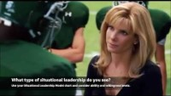
Situational Leadership
In Action

Slide 16

Behavioral Approach to Leadership
A leadership theory approach that emphasizes the behavior of the leader. It focuses on what the leaders do and how they act.
This approach believes that the essence of leadership has 2 dimensions – task behaviors and relationship behaviors.
Task Behaviors = Facilitate goal accomplishment through organizing work, defining roles, establishing procedures, creating policies to accomplish the goal.
Relationship behaviors = Builds trust and respect to connect leaders and followers to attend to the organizational culture by establishing camaraderie.

Slide 17
Behavioral Approach Leadership
Strengths
Critics
Application
Behaviors of leaders affect their followers
Allows leaders to be aware of their leadership style
Considers the task and relationships
No proven performance outcomes
No universal approach
Favorable to high engagement and relationships
Widely applicable in task based applications
Training development programs
Can be altered according to leader or follower behavior

Slide 18


Behavioral Approach to Leadership
In Action

Slide 19

Other Leadership Theories
Trait Approach – Individuals possess leadership traits such as drive for responsibility, persistence in pursuing goals, self-confidence, and ability to influence.
Skill Approach – Emphasizes the capabilities, knowledge, and skills that are needed for effective leadership.
Path Goal – Leaders motivate followers to accomplish the goal by coaching, directing and assisting with overcoming barriers and obstacles.
Authentic Leadership – Focuses on genuine strategies to implement as a leader through practical and personal traits.
Leader-Member Exchange (LMX) – Focuses on interactions between leaders and followers.
Adaptive Leadership – Focuses on the adaption required of leaders to overcome challenges.
Inclusive Leadership – Focuses on the two way influential process between leaders and followers that promotes diversity within an organization.
This Photo by Unknown Author is licensed under CC BY-NC

Slide 20
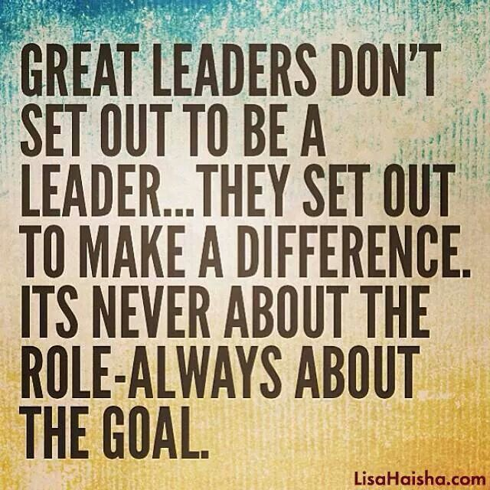
Questions / Discussion
Contact Information
Dr. Anya Bailey Randle
Deputy Assistant Superintendent
Louisiana Department of Education
Anya.Randle@la.gov

