Slide 1

Child Nutrition Finances
Ellen Mason
Notes:
Slide title should be Aptos Bold font, left-aligned, not smaller than 44pt
Audience – To whom/group you are presenting to
Speaker – Who is giving the presentation (may be by name or by department)
Date – Date of presentation

Slide 2
Agenda
Indirect Cost Calculation
Supporting Child Nutrition Fund with Smart Snack Compliance
OHN Updates and Reminders
Q & A
Notes:
Left aligned
Title font is 88pt
Numbered line item 66 pt
Detail/slide item 36 pt

Slide 3
Indirect Cost Calculations

Slide 4

Indirect Cost
Indirect Costs should be charged the same for all Federal Programs
The charge can be the restricted or unrestricted rate or in-between the two
The percentage should be determined at the beginning of the school year and communicated to Child Nutrition. This allows the Child Nutrition Department to budget accordingly

Slide 5
Calculation
Indirect cost is calculated by adding
  salaries,
  employee benefits/ fringe,
  purchased services,
  and other objects multiplied by the indirect cost rate.
The total is multiplied by the chosen percentage between the restricted and unrestricted rate
Purchased Foods, Supplies, and Commodities cannot be included

Slide 6

Questions

Slide 7
Supporting Child Nutrition
Notes:
Agenda is 88 pt
Line item is 66 pt

Slide 8
Smart Snacks Basics
Supporting all parts of the LEA to comply with Smart Snacks Regulations
All foods sold at school during the school day are required to meet nutrition standards. The Smart Snacks in School regulation applies to foods sold a la carte, in the school store, vending machines, and any other venues where food is sold to students.
A number of tools and resources are available to help schools identify food items that meet Smart Snacks criteria. See the resources below for information about the Smart Snacks requirement, helpful tools, and ways to encourage children to make healthier snack choices that give them the nutrition they need to grow and learn.
Notes:
Header font 50pt
Content/body text font 28pt

Slide 9
Why are Smart Snacks important?
Almost a quarter of kids’ daily calories may come from snacks.
Kids who have healthy eating patterns are more likely to perform better academically.
Kids consume more healthy foods and beverages during the school day. When Smart Snacks are available, the healthy choice is the easy choice.
Smart Snacks Standards are a Federal requirement for all foods sold outside the National School Lunch Program and School Breakfast Program.

Slide 10

Vending Machines, School Stores, & Canteens
If vending machines, school stores, and canteens are available to students during the school days, all items must be Smart Snack compliant.
Nutritional documentation must be maintained for ALL items sold in all schools and is subject to audit.
If items are Smart Snack compliant, they can be sold at any time during the school day.

Slide 11
Exempt Fundraisers
Each school site may have up to 30 exempt fundraisers during the school year, and no more than one day in length.
Fundraisers must be tracked by the administration or designated/assigned person
  The cafeteria staff cannot track fundraisers.
Vending machines, school stores, and canteens do not qualify as an exempt fundraiser.

Slide 12

Supporting a la carte sales
Child Nutrition departments depend on a la carte sales
  Reimbursement per free lunch is $4.62 and breakfast is $2.96 for severe need and $2.46 for non-severe need
A la carte sales allow profits to be used to purchase higher quality proteins and more options for breakfast and lunch
Notes:
Food cost for lunch @40% give $1.84 for lunch and $1.18 for breakfast

Slide 13

Alternative Breakfast Service Models
Support alternate breakfast service models
  Breakfast in the Classroom
  Grab and Go
  Second Chance Breakfast or Breakfast After the Bell

Slide 14
Benefits of Increased Breakfast Participation
Higher Test Scores:
Hunger makes school harder. Students who eat school breakfast achieve higher scores on standardized tests.
Calmer Classrooms:
Children who do not regularly get enough nutritious food to eat tend to have significantly higher levels of behavioral, emotional and educational problems.
Fewer Trips To The Nurse:
When kids come to school hungry, they visit the school nurse more often due to stomachaches and headaches. Kids who struggle with hunger are also likely to be sick more often, slower to recover from illness, hospitalized more frequently and more susceptible to obesity.
Stronger Attendance & Graduation Rates:
Students who eat school breakfast attend more school days. Chronic absenteeism, defined as missing three weeks or more of school, decreases by 6 percentage points on average when students have access to Breakfast After the Bell. Attendance is important, as students who attend class more regularly are 20 percent more likely to graduate from high school.

Slide 15

Free Breakfast for All
There is a bill in the SC legislature that would provide state reimbursement for all paid breakfast served in SC.
The state already pays for the reduced student portion of breakfast and lunch.

Slide 16
Questions

Slide 17
OHN Updates and Reminders

Slide 18
Whole Milk
Whole Milk for Healthy Kids Act was signed into law on January 14, 2026.
This bill updates the milk requirements for the NSLP to allow the service of whole and reduced-fat milk.
  Breakfast was not included in this bill
The primary changes include:
  Allowing schools to serve whole and reduced-fat milk at lunch.
  Excludes fluid milk from the saturated fat content calculations for schools.
Note that it is now an option for schools to offer these types of milk, but not a requirement.

Slide 19
Buy American Provision
What is the the Buy American Provision?
The Buy American Provision requires school food authorities (SFAs) to purchase, to the maximum extent practicable, domestic commodities or products. This Buy American Provision supports the mission of the child nutrition programs, which is to serve children nutritious meals and support American agriculture.
The Buy American Provision applies to SFAs located in the 48 contiguous United States and is one of the procurement standards SFAs must comply with when purchasing commercial food products served in the school meals programs.

Slide 20
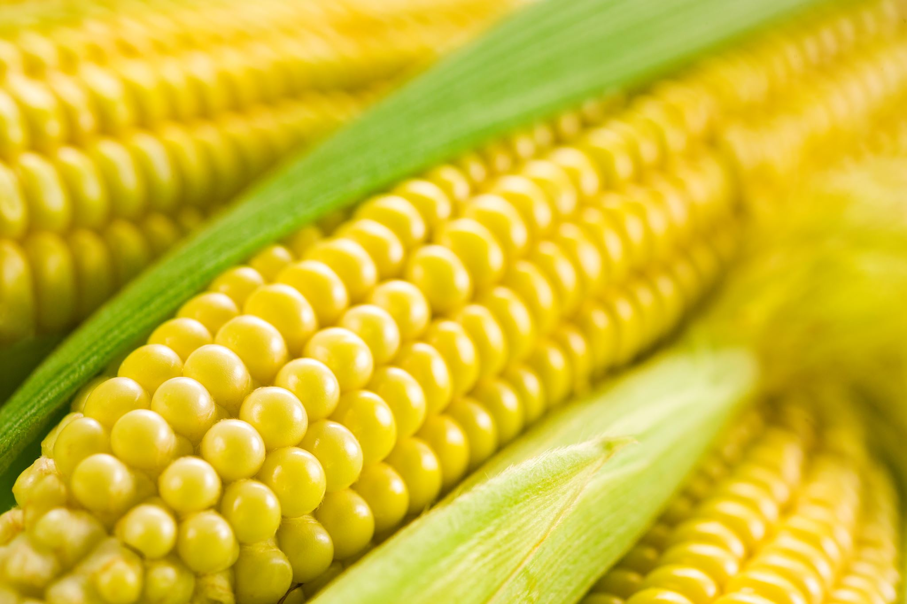
Temporary Accommodation
Will allow SFAs to exceed the 10 percent threshold.
State agencies will provide technical assistance to SFAs to support the temporary accommodation consistent with the availability of the two regulatory exceptions for non-domestic purchases as SFAs demonstrate they are unable to meet the requirement.
A temporary accommodation for the threshold requirement is only available for non-domestic purchases that qualify under one or more of the regulatory exceptions.

Slide 21
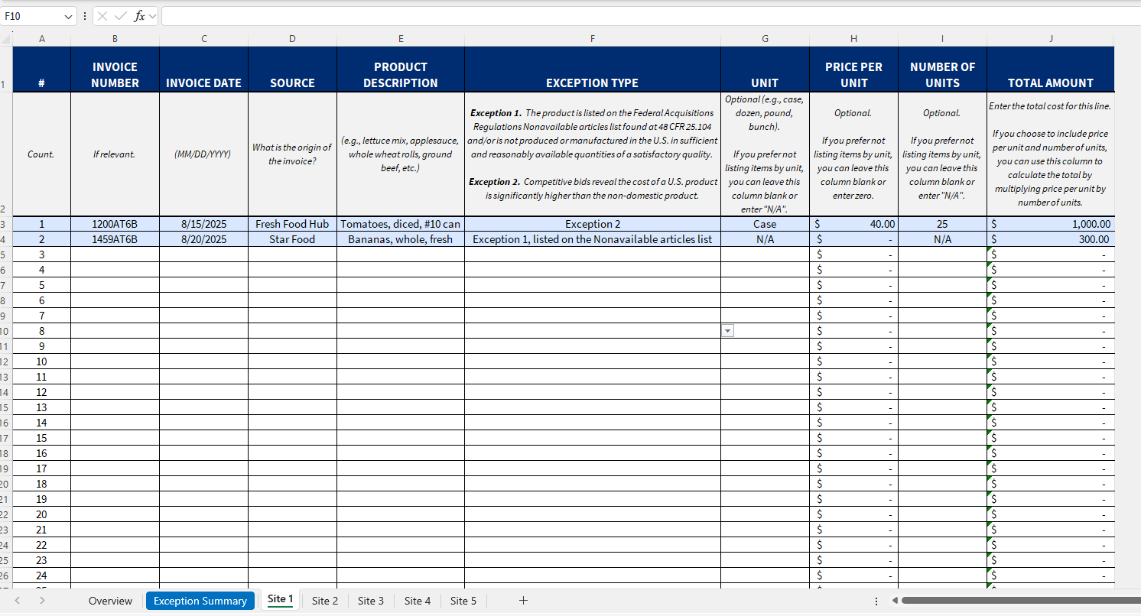
Tracker

Slide 22

Buy Local Buy Fresh

Slide 23

SLP-4 Updates
We have updated the SLP-4 form.
  It has not been updated in SCAPS, yet
The new form was used for the 2024-25 reports

Slide 24
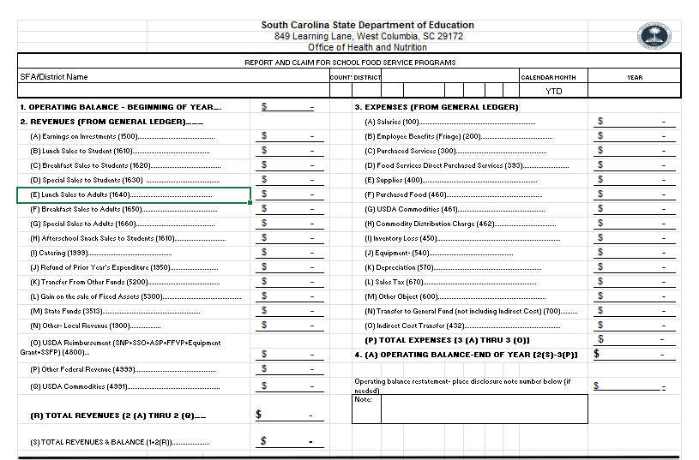
New top of the form

Slide 25
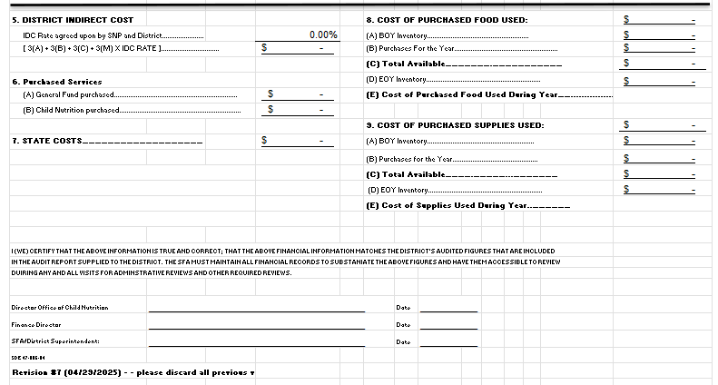
New bottom of form

Slide 26

Review Cycles
ARs and Procurement Reviews are both on a 5-year cycle.
  They may or may not be in the same school year.
SFAs will significant findings during an AR will have a targeted review 2 years after the AR occurs.

Slide 27

ICN Training
Colleton County is hosting an ICN Financial Management Training
Sign up by March 13th with Kristian Wallace Child Nutrition Director at Colleton

Slide 28
SCDE Trainings
Team Up
  April 22-23
  SCDE Offices in Columbia
Area Meeting in late May and June

Slide 29
Questions

Slide 30
Contact Information
Ellen Mason, emason@ed.sc.gov
Vanesha Perrin, vrperrin@ed.sc.gov

Slide 31
ed.sc.gov
Notes:
Slide title is hidden from display

