Slide 1


SC Department of Education
Division of Financial Services
March 5, 2026

Slide 2

Student Success
Summer Reading Camps – $30M (recurring)
Funding to ensure that the significant increase in number of students who must be served under law will receive services
Our commitment to “Student Success” ensures every child gains foundational skills for lifelong achievement. Through evidence-based programs like the Science of Reading and Palmetto Math Project, we strive to equip all students to excel in school and life.
HQIM – $50M (non-recurring), $20M (recurring)
Funding for purchase of HQIM in multiple subject areas and to prepare for an upcoming statewide Social Studies purchase.
Education Scholarship Trust Fund – $61M (recurring)
Funding for Year 3 of ESTF program
Learning Management System – $8.2M (recurring)
Funding will maintain a digital classroom environment statewide allowing data to be collected, matched to assessment scores, and evaluation of the effectiveness of the content.
Fiscal Oversight and Data Infrastructure – $3,780,000 (recurring)
Funding will be used to develop a statewide finance data platform. Funding will support struggling districts, and ensure accurate, transparent statewide finance data.
Notes:
Budget requests fall into three major categories
Student success:
$30M recurring for Summer Reading Camps – we received $23M NR this year and only $7M recurring; requesting $30M recurring to cover addition of 1st and 2nd graders next summer; Ways & Means approved $15M recurring
HQIM – Asking $50M NR and $20M recurring; Approx $30M in maintenance orders; need for materials for new math standards with a focus on new Algebra I materials, and additional funds to help toward social studies standards; W&M approved a total of $38.3M
ESTF – year 3 to cover 20k additional students; more than 26k students showed interest last school year; W&M funding at $23.2M to cover 15k additional students
Learning Management System - funding for a statewide, centralized digital classroom environment for delivering curriculum and assessments that are mapped to state standards to enable consistent instructional practices and data collection across districts; fully funded by W&M
Fiscal oversight and data infrastructure – part of the DASBP recommendations; $3.2M for a data dashboard aimed toward ease and efficiencies for district finance staff, transparency for stakeholders and policy makers, identifying early warning indicators to initiate technical support needs, and $580k for salary and fringe to build out the fiscal practices team to create more support on the front end; part of our goal to make fiscal practices more proactive and helpful rather than reactive and punitive. W&M funded the $3.2 NR for the dashboard but not the additional salary and fringe.

Slide 3

Teacher Support
State Aid to Classrooms: Teacher Salaries - $150M (recurring)
Increase starting teacher salary to $50,500
Our commitment to "Teacher Support" recognizes that a quality educator is the #1 in-school indicator of student success. By focusing on competitive salaries, enhancing professional growth opportunities, and cultivating strong leadership, we aim to retain high-quality educators and foster a supportive, growth-oriented environment across South Carolina schools.
Strategic Compensation Pilot: Phase 3 - $5M (non-recurring)
Continued funding will allow participating districts to continue pilots
Strategic Teacher Career Ladder Pilot - $1.4M (non-recurring)
Pilot program to enhance the effectiveness of school leaders to drive academic excellence and improve student outcomes across the state
Notes:
Next category, Teacher Support – all requests have been recommended by W&M
$150M in SAC for teacher salaries – matches the Governor's request of $50,500;
Strategic Comp Pilot – year 3; well received and hoping to keep this program moving forward
Strategic Teacher Career Ladder Pilot – pilot program to offer additional avenues for teachers to increase their compensation other than simply time and degrees, or leaving the classroom to pursuit administration positions if they prefer the classroom

Slide 4

Safe Schools
SC Education Infrastructure Bank – $120M (recurring)
Establish a permanent, comprehensive solution to provide sustainable funding for rural public and public charter school facility construction, renovation, and modernization
Our commitment to "Safe Schools" prioritizes investments in infrastructure, transportation, and security, ensuring students have access to a safe, well-maintained environment conducive to learning. These initiatives support modern facilities, safety upgrades, and reliable transportation, all of which are essential to promoting access to an excellent education.
Pilot of School Safety Personnel Program – $347,500 (non-recurring)
Pilot will allow SCDE to partner with districts and law enforcement entities to develop and implement training
Disconnect to Reconnect $17,628,472 (non-recurring)
Materials to ensure age-appropriate instruction about the impact of smartphones, screens, and social media
SAFE K-12 Implementation Support – $1.8M (non-recurring) and
$1.72M (recurring)
Funding will enable districts to meet cybersecurity requirements in S.C. Code and implement safeguards
Bus Lease/Purchase – $40M (recurring)
Maintain the state-mandated fifteen-year replacement cycle
Notes:
Finally Safe Schools
Infrastructure Bank – this was an ask last year, this is one of the Department's priority asks this year to address aging infrastructure at the districts rather than non-recurring capital funds. W&M recommending $95M NR
Pilot of School Safety Personnel – similar to the Florida Guardian Program to provide training and certification for armed school employees through SLED; this does NOT replace SROs, this would be a supplement to existing SRO presence; Not funded by W&M
Disconnect to Reconnect – this request would establish the purchase of science-based materials to educate 3rd – 8th grade students with age-appropriate instruction about the impacts of smartphones, screen time, and social media. Not recommended by HW&M
SAFE K-12 Support – NR and Recurring funds to assist and support districts with cybersecurity requirements and implementation of safeguards; W&M did not recommend funding
Lastly $40M recurring for school bus leasing and purchasing to maintain the state mandated 15-year replacement cycle; W&M approved $2M recurring and $28M NR

Slide 5
Agenda
Grants Accounting Updates
Quarterly Expenditure Deadline
Technical Assistance Sessions

Slide 6


Quarterly
Expenditure
Deadline
Quarter | Reporting Period | New Due Date (30 Days)
Q1 | July – September | October 30th
Q2 | October – December | January 30th
Q3 | January – March | April 30th
Q4 | April – June | July 30th through August 15th
The Office of Management and Budget (OMB) revised 2 CFR 200.328 and 200.329 , updating the requirement for financial reporting. Under the new language, sub-recipients must submit quarterly claims within 30 calendar days after the end of the reporting period. Previously, SCDE allowed 45 days for claim submissions.
Notes:
To remain fully aligned with federal guidance, SCDE will transition to the 30-day submission standard for all new sub-awards. Existing active sub-awards will retain the 45-day reporting timeline originally issued in their award terms, and SCDE will continue to honor those timelines through the end of the current fiscal year unless an amendment is issued. SCDE remains committed to supporting districts in maintaining compliance while balancing operational needs and year-end reconciliation timelines.
While federal regulation would make July 30 the required due date for Quarter 4 reporting, SCDE is exercising its discretion to extend a grace period through August 15 in recognition of limited summer staffing, year-end fiscal reconciliation, and the processing of prior year claims. This grace period applies to both current and new awards to support consistent reconciliation practices across all districts.

Slide 7
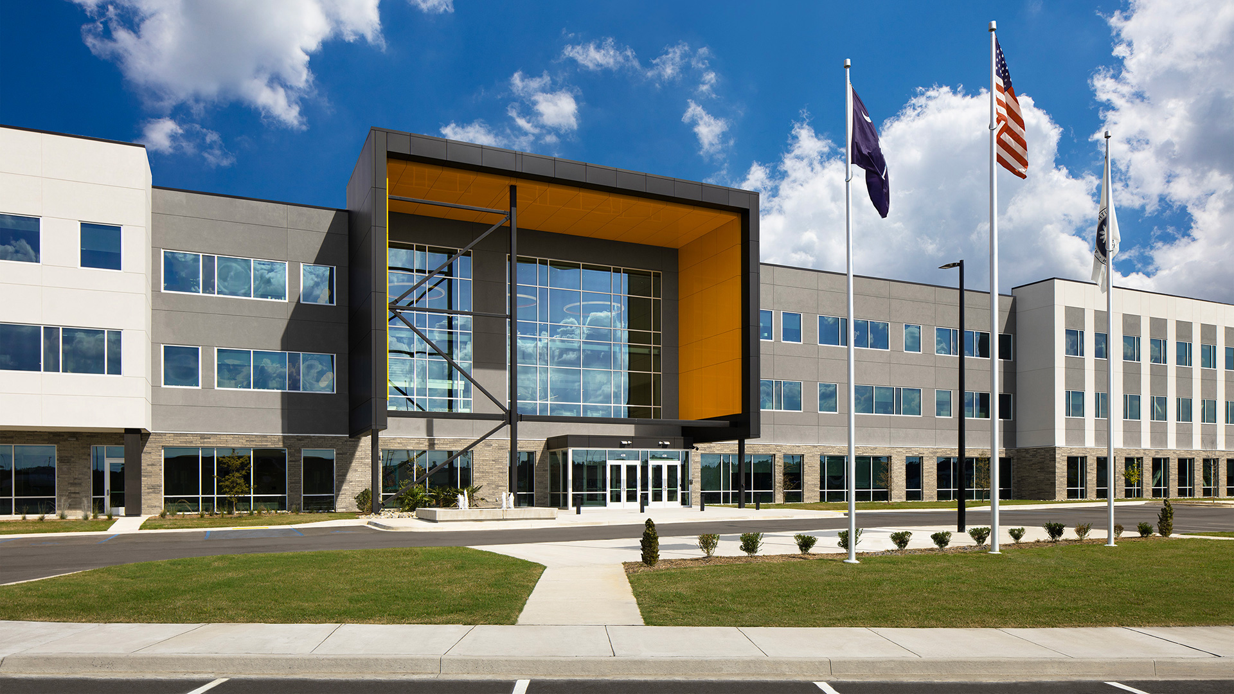
Technical Assistance Sessions
The SCDE Grants Accounting team offers one-on-one GAPS Technical Assistance (TA) sessions, providing an in-depth walkthrough of the Grants Accounting Processing System (GAPS) for both new and existing users.
Looking ahead, we’d love to host smaller, more personalized district sessions during future SCASBO conferences. If you’re interested, please feel free to connect with me after the presentation!
Notes:
The SCDE Grants Accounting team provides one-on-one GAPS Technical Assistance sessions to help both new and current users better understand how to navigate the system. In the future, we’d love to host smaller, more focused sessions for each district during SCASBO. If that’s something you’d like to be part of, please connect with me after today’s presentation.

Slide 8
Agenda
Audit Services Updates
Financial Accounting Handbook Update
Annual Audit Submission Update
Records Retention Policy – SC Department of Archives and History

Slide 9
Financial Accounting Handbook Updates
Added revenue codes
Updated special education revenue and function code title descriptions and definitions
Updated objects 340, 345, 350, 420, 430, 440, and 445 definitions
Replaced LEA with School District
Questions from Financial Accounting Handbook Committee

Slide 10
Financial Accounting Handbook Updates
Added revenue codes
  3103 – State Aid to Classrooms
  3171 – Consolidation and Capital Improvement
  3503 – State Aid to Classrooms
  3513 – Child Nutrition
  3567 – CPR Instruction
  3590 – School Building
  3630 – K-12 Technology Initiative (Carryover Only)
  3660 – Mobile Device Access and Management (Carryover Only)
  3670 – School Safety-Facility and Infrastructure Safety Upgrades
  4932 – SC Pathways Project
  4936 – South Carolina Early Learning Extension
  4939 – Stronger Connections

Slide 11
Financial Accounting Handbook Updates
Updated special education revenue and function code titles descriptions
  3315 Trainable Intellectual Disability
  3316 Speech Disability
  3321 Emotional Disability
  3322 Educable Intellectual Disability
  3324 Hearing Disability
  3325 Visual Disability
  3326 Orthopedic Disability
  4140 Students with Disabilities
Same updates made to Exceptional Programs function codes 121 – 126, and 128
Same updates made to Preschool Programs function codes 131 – 138
Revenue and function code definitions were updated to "students with disabilities"
These updates are pending program office approval
  Do not update your accounting system until handbook has been posted on SCDE's website

Slide 12
Financial Accounting Handbook Updates
Updated objects 340, 345, 350, 420, 430, 440, and 445 definitions
  340 - Communication. Services provided by persons or businesses to assist in transmitting and receiving messages or information. This category includes telephone and voice communication services. Phone lines used specifically to support classroom instruction may be charged to the appropriate instructional function.
  345 - Technology. Expenditures for technology hardware and software services provided by persons or businesses not provided directly by school district personnel. Maintenance contracts, repair services for technology, data communication services to establish or maintain computer-based communications, networking, and internet services; video communications services to establish or maintain one-way or two-way video communications via satellite, cable, or other devices should be charged here. Includes licenses and fees for services such as subscriptions to research materials over the Internet (such as downloads). Costs for Instructional Television Program user licenses are included in this object. Expenditures for software should be coded to Object 445 if the software was not capitalized or Object 545 if the software is eligible for capitalization.

Slide 13
Financial Accounting Handbook Updates
Updated objects 340, 345, 350, 420, 430, 440, and 445 definitions
  350 - Advertising. Expenditures for announcements in professional publications, newspapers, or broadcasts over radio and television. These expenditures include advertising for such purposes as personnel recruitment, legal ads, new and used equipment, bond sales, and sale of property. Costs for professional advertising or public relations services are not recorded here, but are charged to Object 395.
  420 - Textbooks. Expenditures for prescribed books which are purchased for pupils or groups of pupils, and resold or furnished free to them. Included here are textbooks made available online, digital textbooks. This category includes the costs of workbooks, textbook binding or repairs, as well as the net amount of textbooks which are purchased to be resold or rented.

Slide 14
Financial Accounting Handbook Updates
Updated objects 340, 345, 350, 420, 430, 440, and 445 definitions
  430 - Library Books and Materials. Expenditures for regular or incidental purchases of library books, globes, and maps available for general use by students, including any reference books, even though such reference books may be used solely in the classroom. Also recorded are costs of binding or other repairs to school library books. Audio books and ebooks are charged here. The initial purchase of books or materials for a new school library or an expansion of the library are recorded under Capital Outlay as Object 560.
  440 - Periodicals. Expenditures for periodicals and newspapers for general use in the school library. A periodical is any publication appearing at regular intervals of less than a year and continuing for an indefinite period. This includes online periodicals.

Slide 15
Financial Accounting Handbook Updates
Updated objects 340, 345, 350, 420, 430, 440, and 445 definitions
  445 - Technology and Software Supplies. Expenditures for technology items and supplies used in conjunction with technology-related hardware or software (not purchased as part of an initial computer purchase), noncapitalized technology items, such as, CDs, flash or jump drives, parallel cables, monitor stands, printer cartridges and ribbons, software downloads below the capitalization threshold, and digital applications, etc. Also included here are items such as e-readers, including Kindles, and iPads, that fall below capitalization thresholds.

Slide 16
Financial Accounting Handbook Updates
Committee Member Questions Received and Answers Provided
  Revenue 4820 - Supply Chain Assistance Funding - Is there a deadline for expending these funds? There is not a deadline for expending these funds.
  Function 139 (Early Childhood Programs) and 147 (Full Day 4K) - Can you help me understand the difference between functions 139 and 147? Is this just for the SPED population? Function 139 is for the district's early childhood programs (revenue Code 3540) that serve 4-year-old students and some 3-year-olds. This is the district's non-CERDEP 4-year-old programs. Students in function 139 are not students receiving special education services. Four-year-old students who are receiving special education services should be classified in the applicable Exceptional Programs function for preschool students (functions 135-138). Function 147 is for children participating in CERDEP (revenue codes 3541 and 3134).

Slide 17
Financial Accounting Handbook Updates
Committee Member Questions Received and Answers Provided
  Function 251 - Is this function to be used for instructional classes beyond the regular school day? Function 251 is not just for transportation beyond the school day. This is for transportation related to federal programs that takes place during the school day as well. For example, transportation of students for the CTE program (Revenue Code 4210) to attend class at another facility, which occurs during the regular school day, would be recorded here. This is also to record transportation of students to instructional classes other than instructional classes related to federally funded programs throughout the school day. For example, transportation that may be related to students attending a class at another high school.

Slide 18
Financial Accounting Handbook Updates
Committee Member Questions Received and Answers Provided
  Function 255 - Is this function to be used for instructional classes DURING regular school day/school year? This function is solely for transportation of students from home to school. It is not for transportation of students to instructional classes during the regular school day. Transportation of students to instructional classes during the regular school day should be recorded in function 251.
  Function 339 – Other Transportation Services - An example of when this can be used is for reimbursements of travel costs for a contractor. It could be someone hired to provide professional development and the contract between the district and the contractor includes reimbursement of the contractor's travel expenses. A district may not ever have this type of cost or may rarely have this type of cost.

Slide 19
Financial Accounting Handbook Updates
Committee Member Questions Received and Answers Provided
  Function 393 – Food Service Direct Purchase Services - If we outsource food service, and our contract is based on number of meals served, would the posting of my monthly invoice just be charged to 393? Yes, if you are outsourcing food service and your contract is based on number of meals served, your posting would just be included in Object 393.

Slide 20
Annual Audit Submission Update
Annual Audit Submission Deadline – Remains December 1
  Annual audits for fiscal year 2025-26 due Tuesday, December 1, 2026
New for fiscal year 2025-26 submissions
  Management Letter Upload in LARS
    System will ask "Did you receive a Management letter?"
    If yes, upload of Management Letter required
Annual Audit Submission Reminders
  Check Error Summary tab for errors and final warning acceptance
Audit submissions for 2024-25 are in the process of being approved
Due Tos for fiscal year 2024-25
  Will be mailed by April 3, 2026
  Due by April 23, 2026

Slide 21
Agenda
District Financial Services
Important Dates/Deadlines
Office Updates

Slide 22
Important Dates
March 30
135th-Day Pupil Accounting
June 30
March 30-April 21
April 30
Home Instruction Report
Certify data using link provided in Memo and Newsletter
Final Deadline for SC Educator Staff Records
SC Educator/ Funding Flexibility
FY26 Funding Flexibility forms

Slide 23
Office Updates
Summer Reading Camp
February Initial allocation
Fund Balance Reporting
General fund balance must be submitted via Formstack by the 20th of each month
National Board
Non-teaching Occupational Experience
Districts are required to apply the corresponding salary adjustment at the beginning of the next school year following the effective date of the recorded experience adjustment. The statute does not mandate mid-year implementation, nor does it authorize retroactive pay
Districts may request a current roster of employees receiving the National Board stipend, and notify our office of any needed updates via email to mcooper@ed.sc.gov
March additional funding

Slide 24
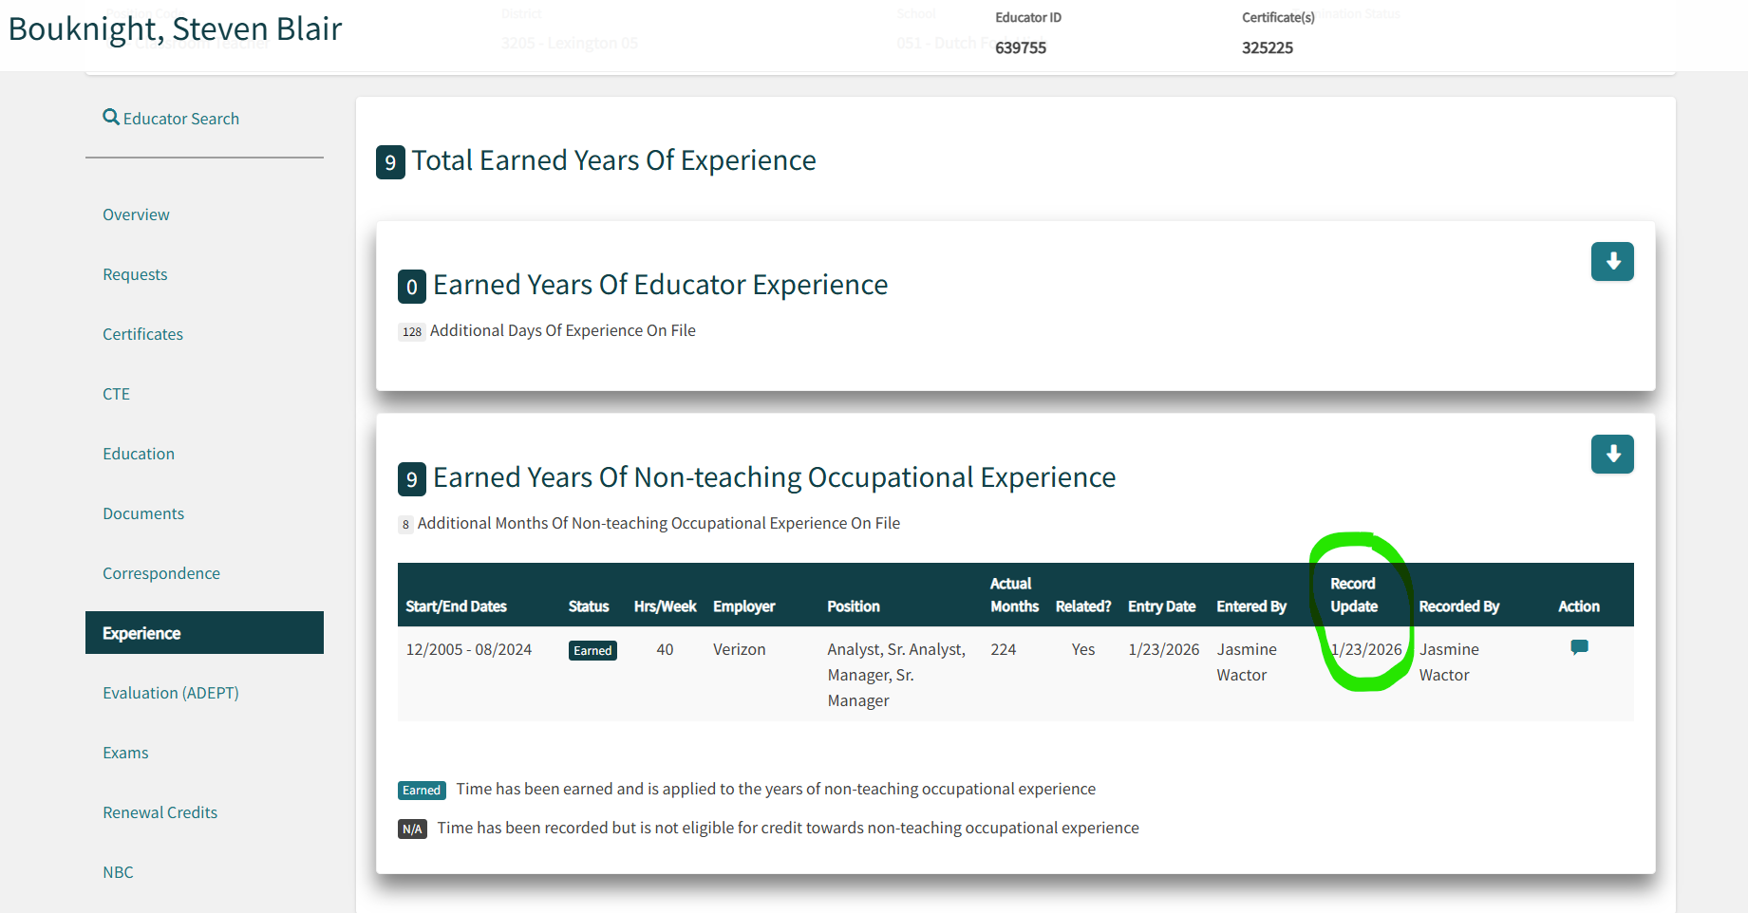

Slide 25


THANK
YOU

